Slide 1
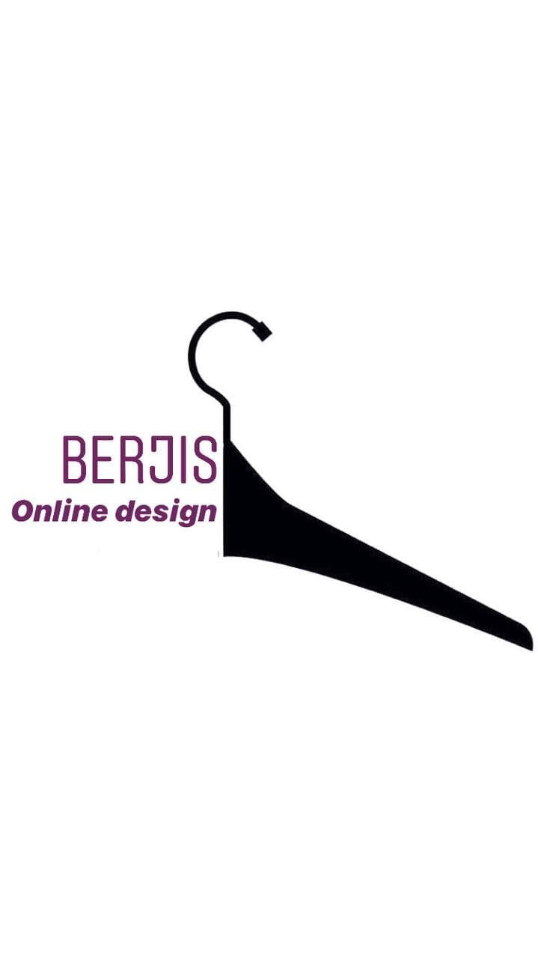
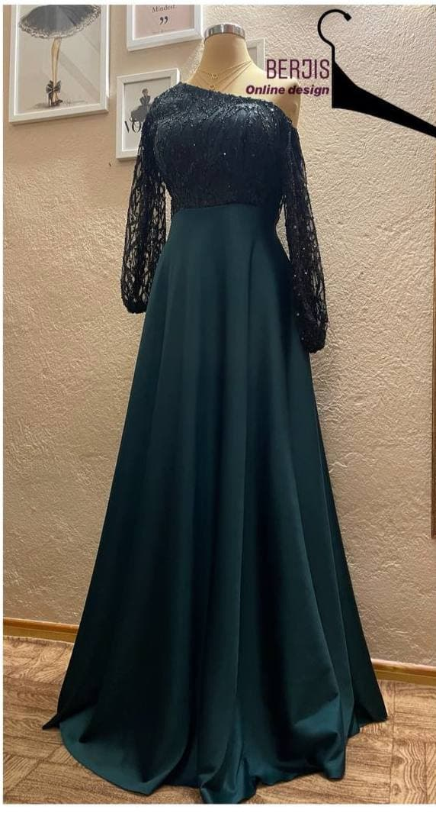
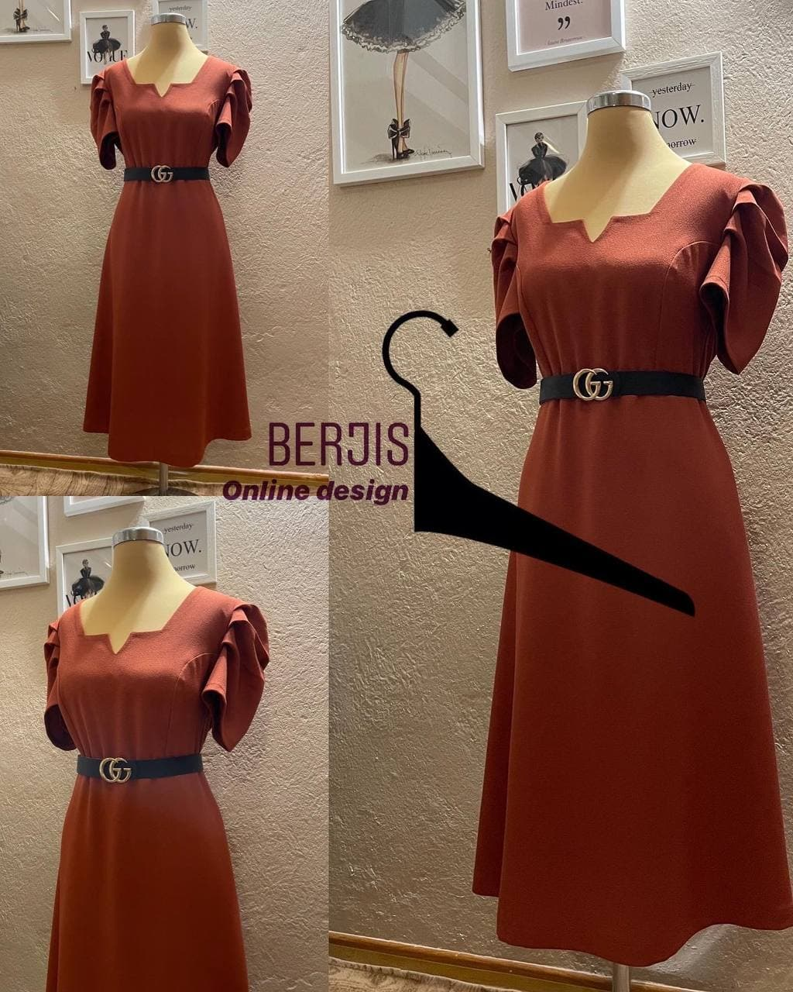
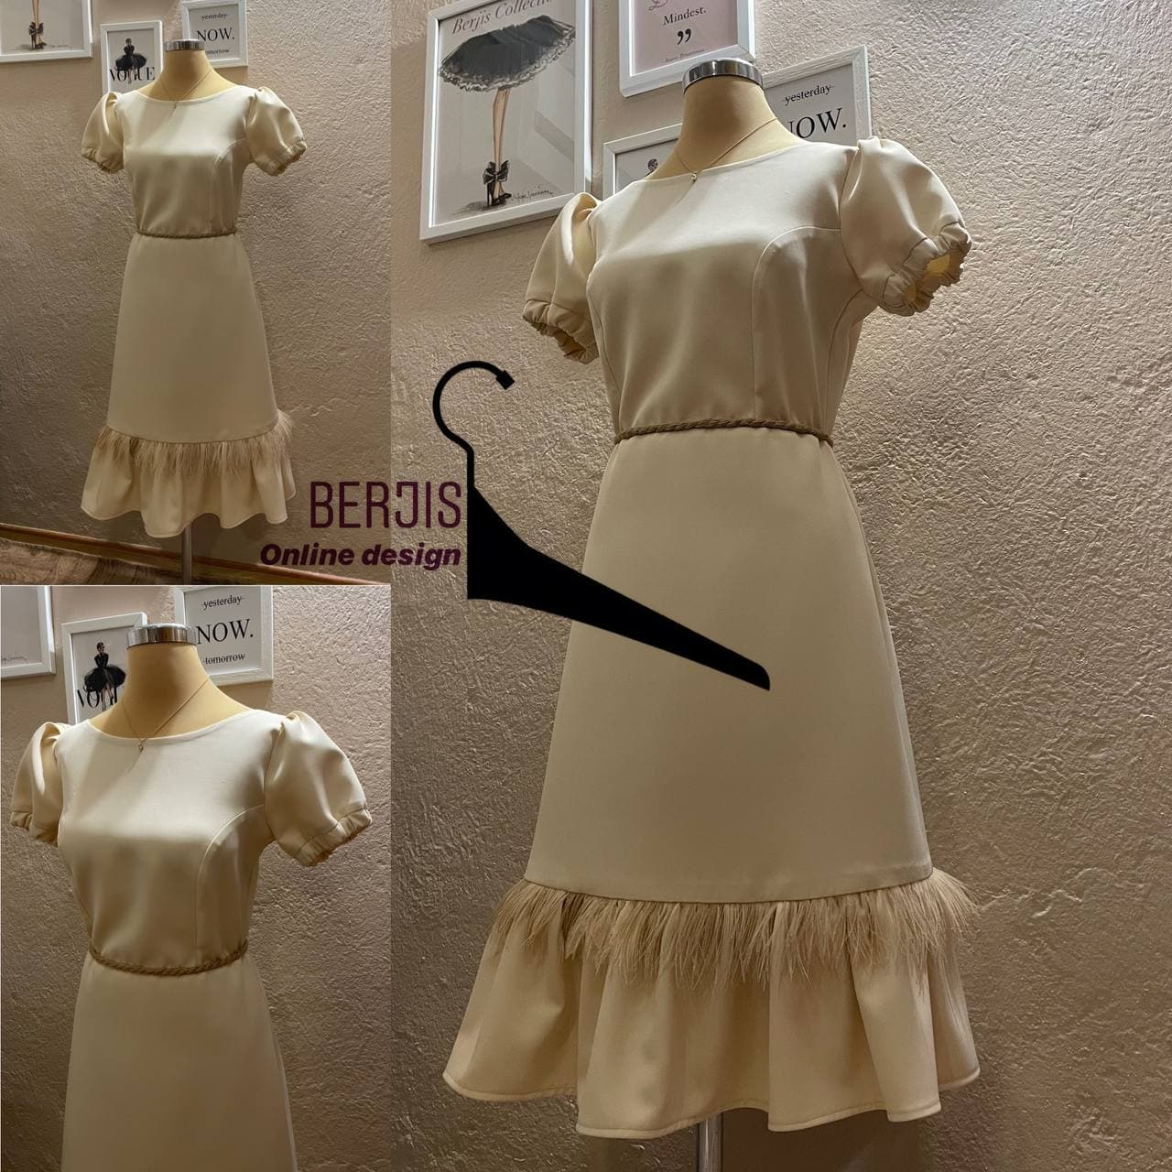
Hello, at your request, we will see some examples of my prepared works and I tried to give a short explanation next to it. My job is to do everything from patterning to cutting and sewing myself. In fact, from zero to one hundred jobs are done by myself.
Notes:
Hello, at your request, we will see some examples of my prepared works and I tried to give a short explanation next to it.

Slide 2
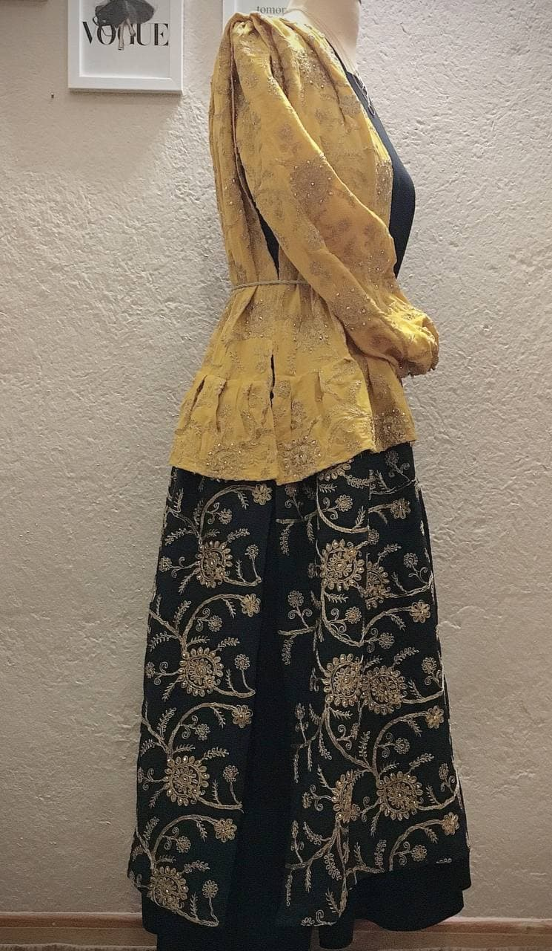
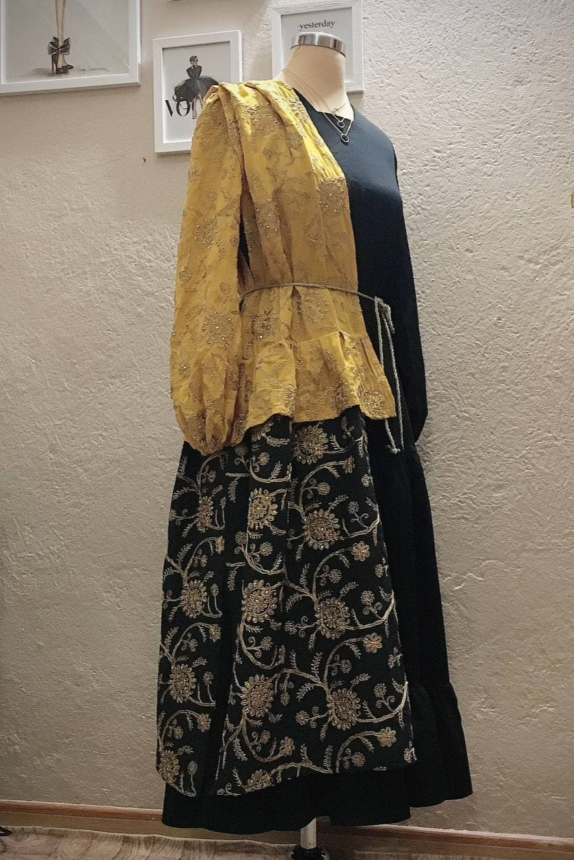
A traditional design from the people of southern Iran who love bright and shiny colors and the fabric I used is handmade.

Slide 3
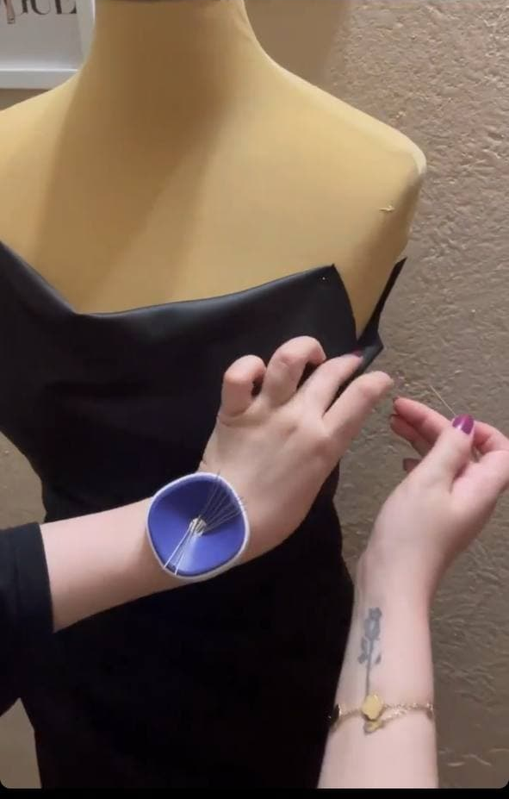
Black can be a bold choice for a lady for a formal party. But playing with fabric and creating small and large drapes can make it more special. In this technique, the fabric is designed by pattern and mannequin.

Slide 4
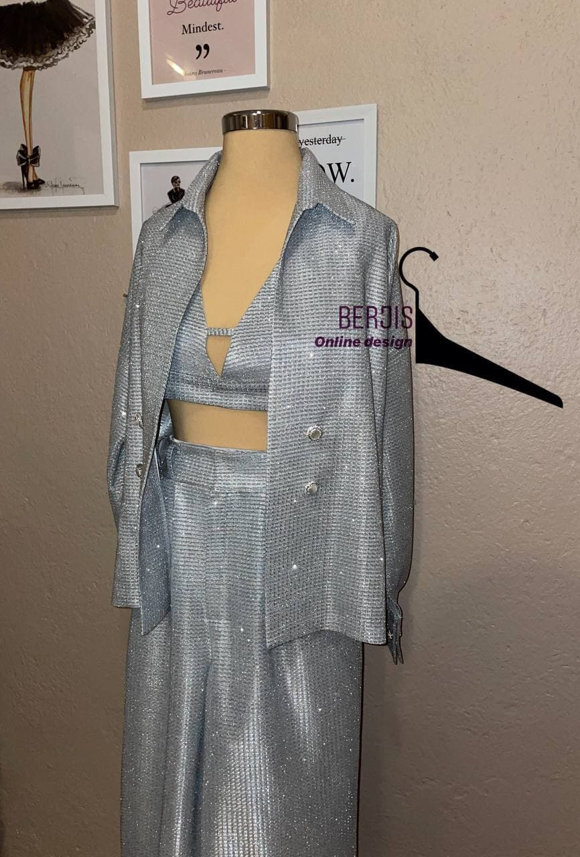
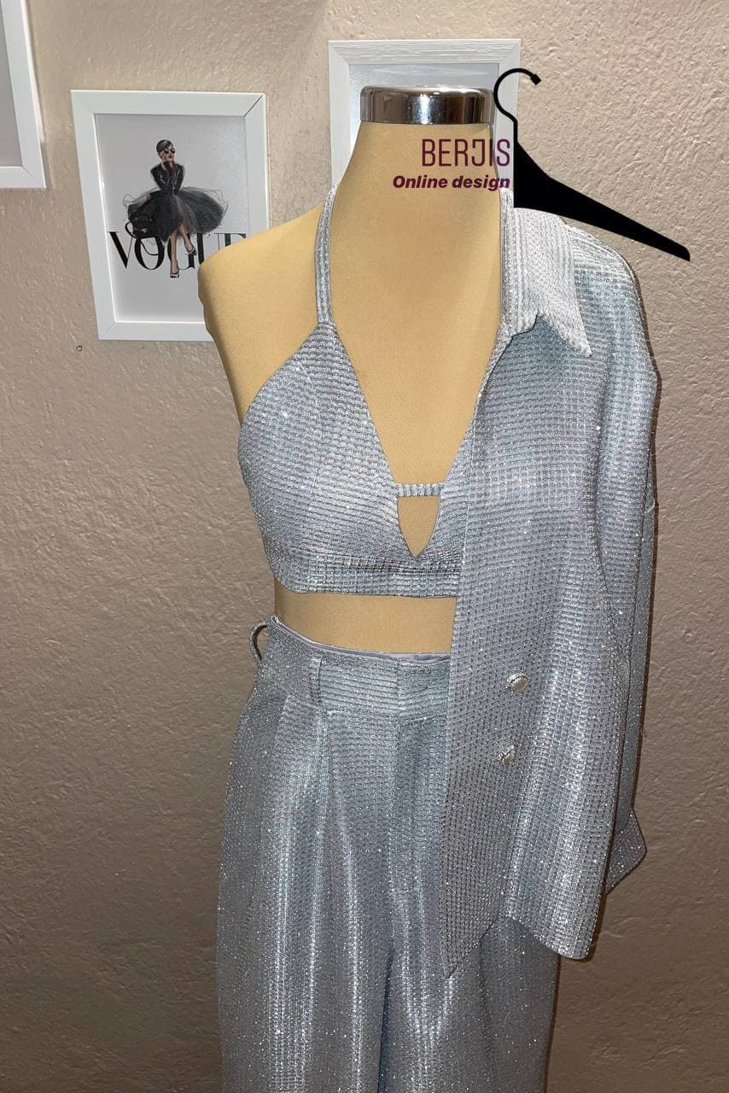
One of my brightest things is this set. Combining pants with a brassiere with an overcoat that can be worn in different situations. My client had a slim waist and I wanted to show this. The pants also made her taller. I used pearl buttons that were full of jewels and matched the dress

Slide 5
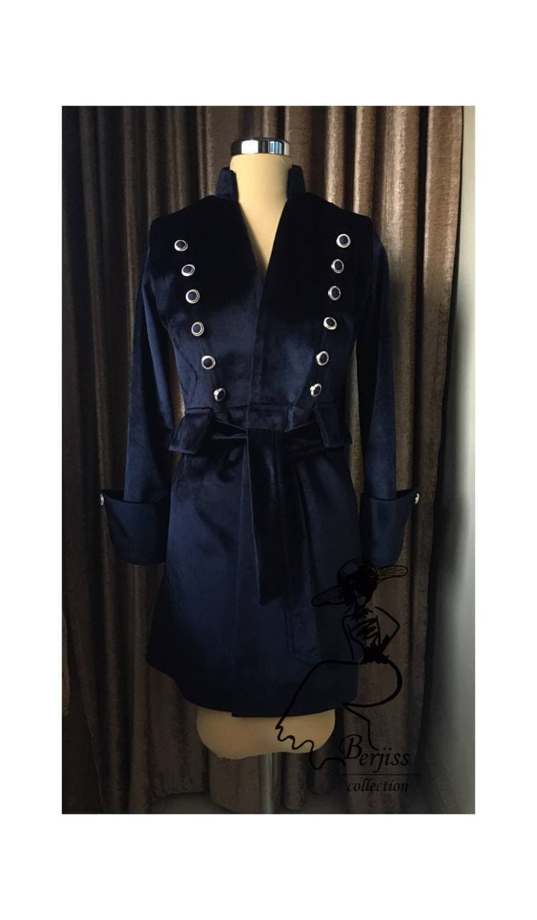
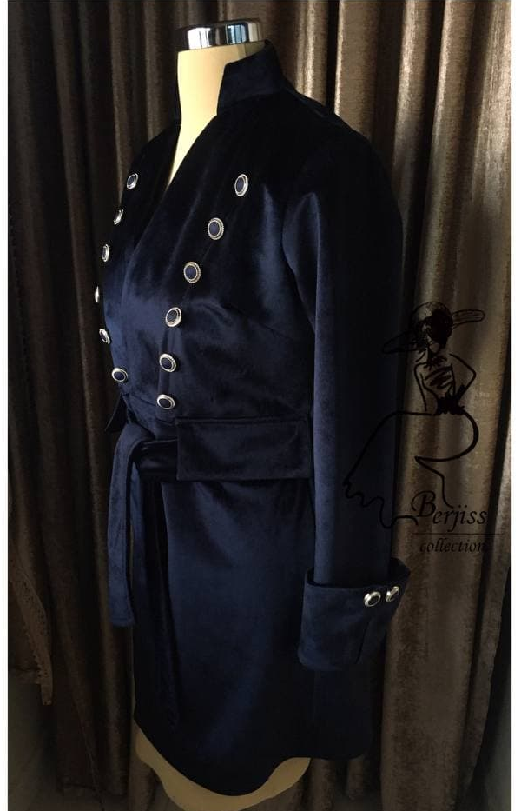
This coat is inspired by equestrian sports, the fabric is velvet, and I used gold buttons next to the dark crimson color to give it a special look.

Slide 6
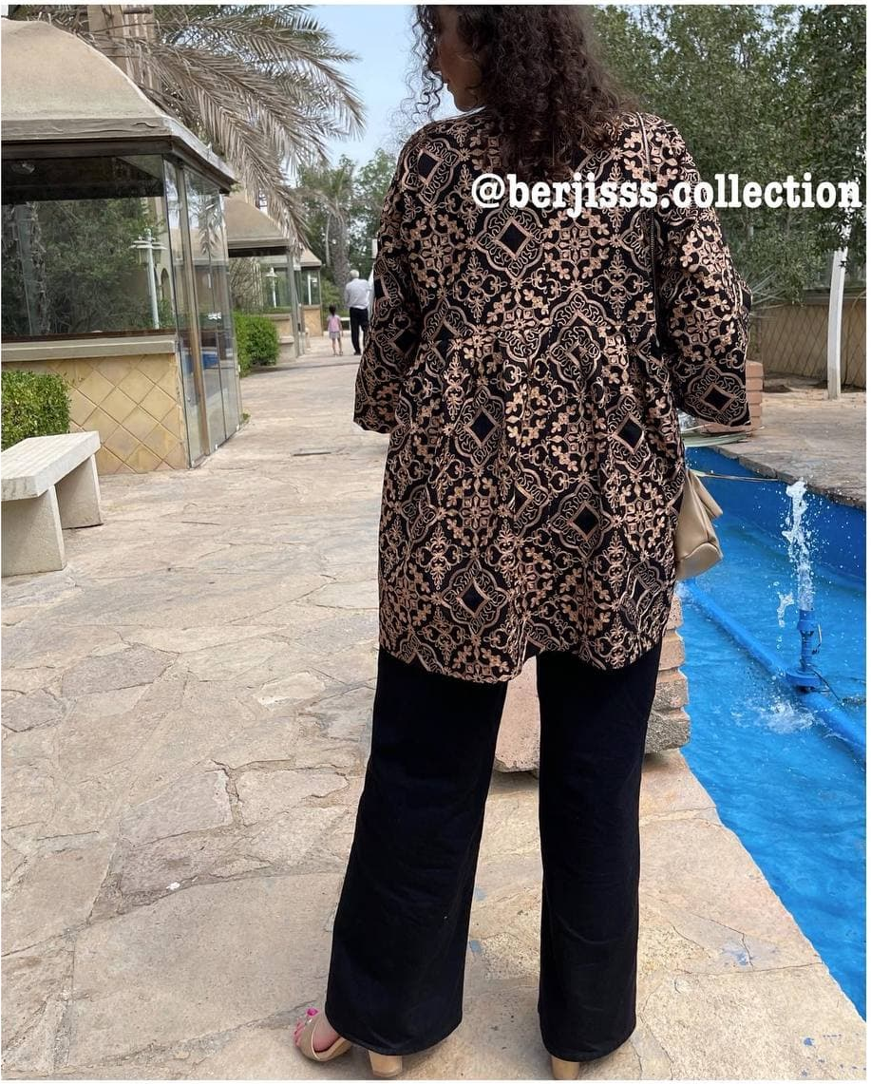
This is a manteaux.in iran, women wear the same thing in different models. Open front dress with cut from the waist with large piles inspired by the Qajar period that in addition to women, men at that time also wore such clothes.

Slide 7
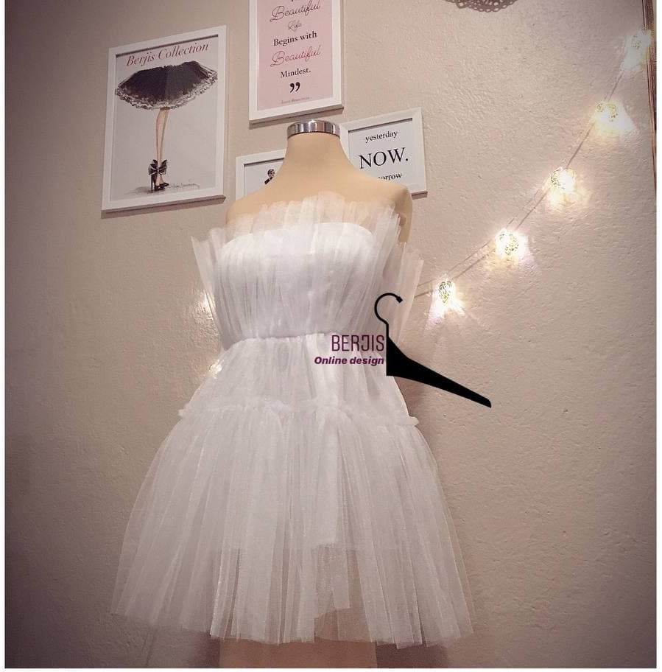
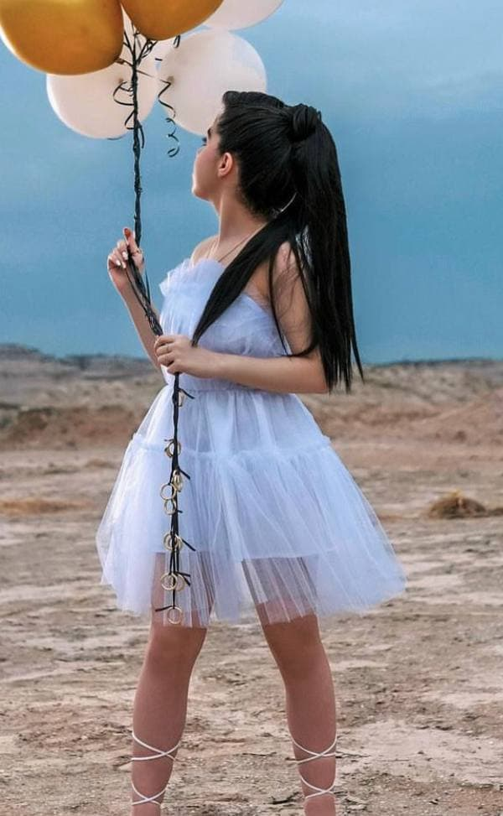
I designed a white doll dress for the birth of a young girl. With her short skirt, I showed her beautiful and elongated legs. At first glance, the design of the dress gives the feeling of a white swan in the lake. Lace fabric like a swan feather.

Slide 8
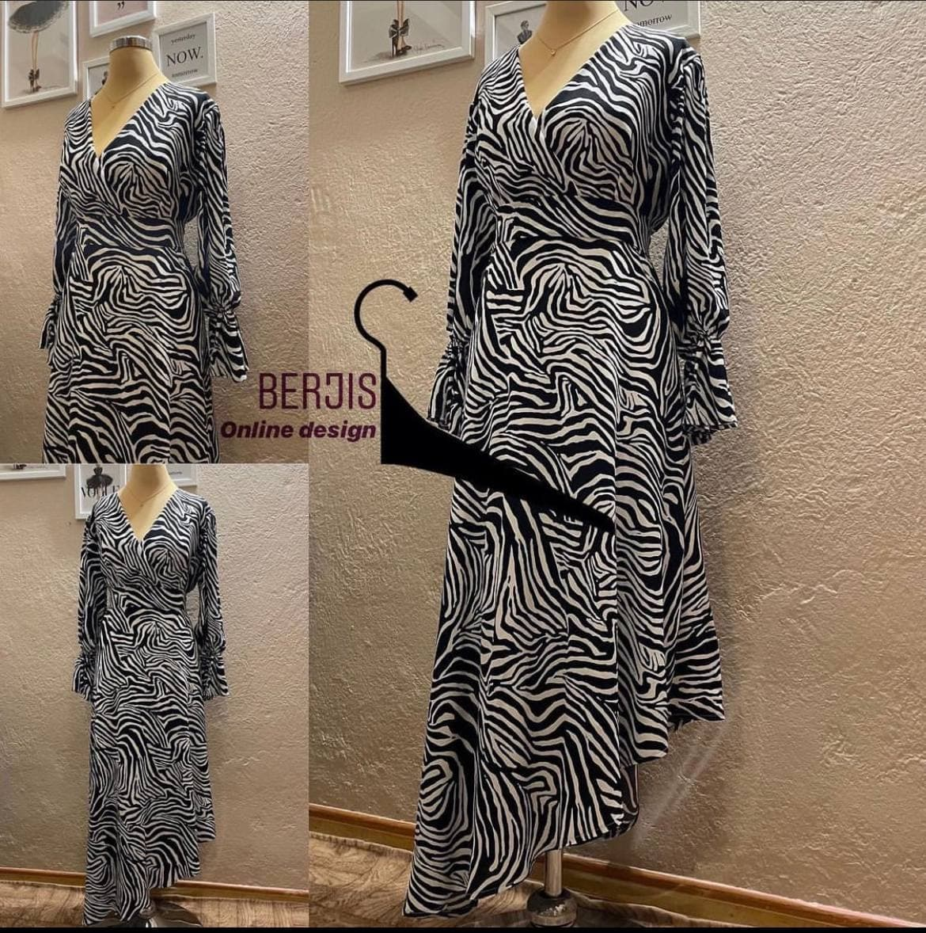
Spanish dance long dress, short on one side of the dress makes the movements of the dancer's feet show elegance, I used silk crepe fabric to put the light dress on the body like a bird feather.

Slide 9
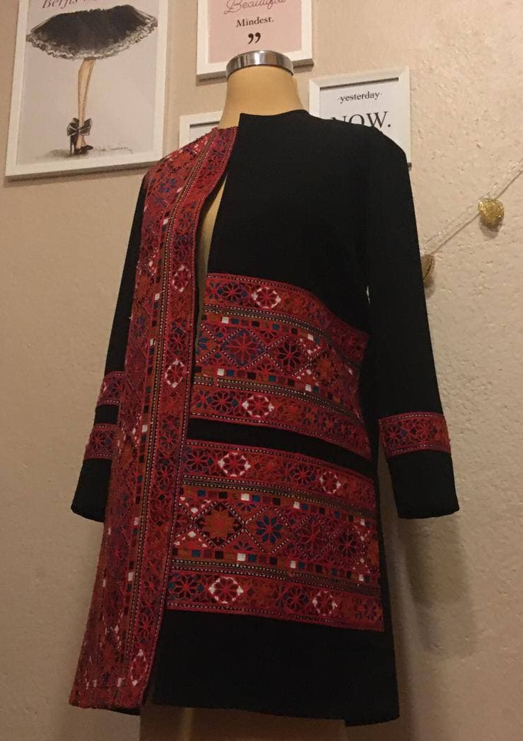
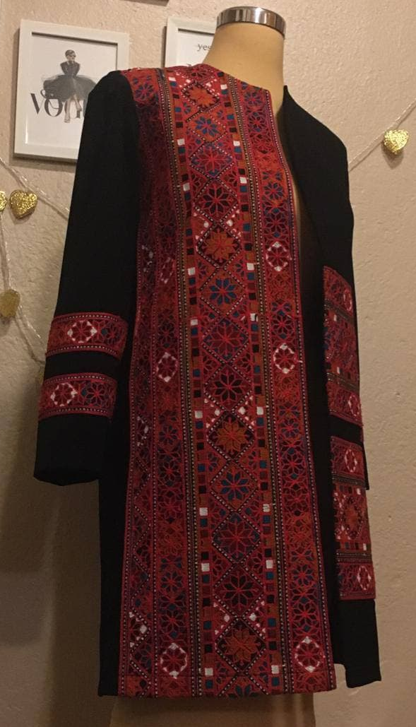
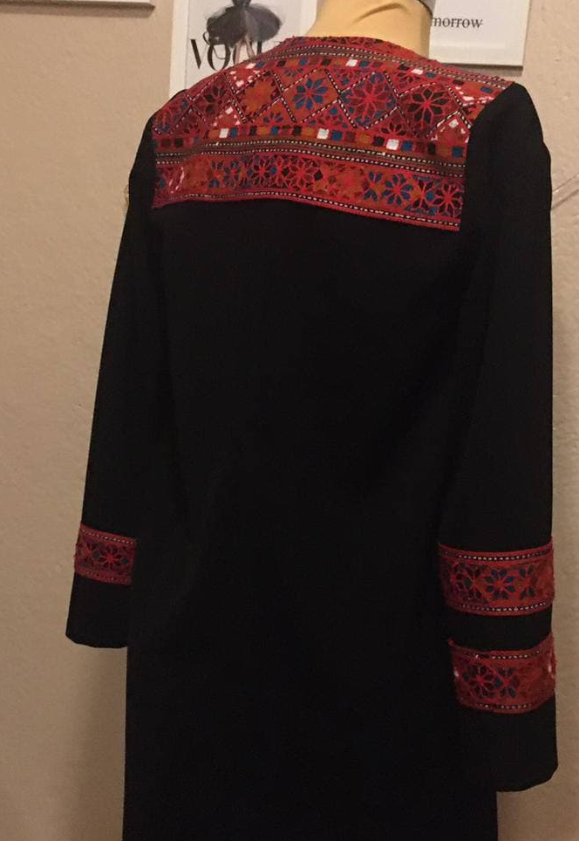
This is inspired by the people of Sistan and Baluchestan, in fact they use the term Baluchi, the design of the fabric is like a carpet that is sewn on the work in the form of strips of different widths.

Slide 10
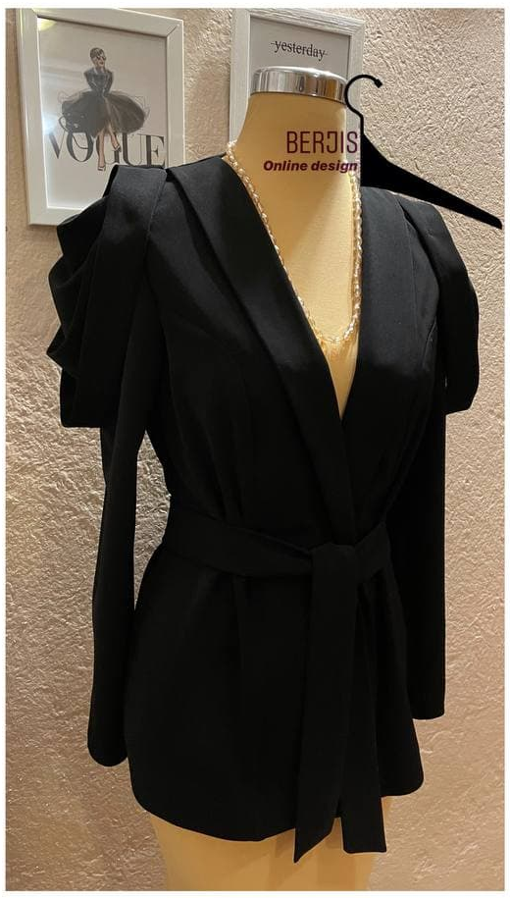
Since the client had large breasts, I used the slim collar we call Arshal and tried to make her small shoulders look bigger with a drape on the sleeves. The wide straps on her shoulder are inspired by military uniforms.

Slide 11
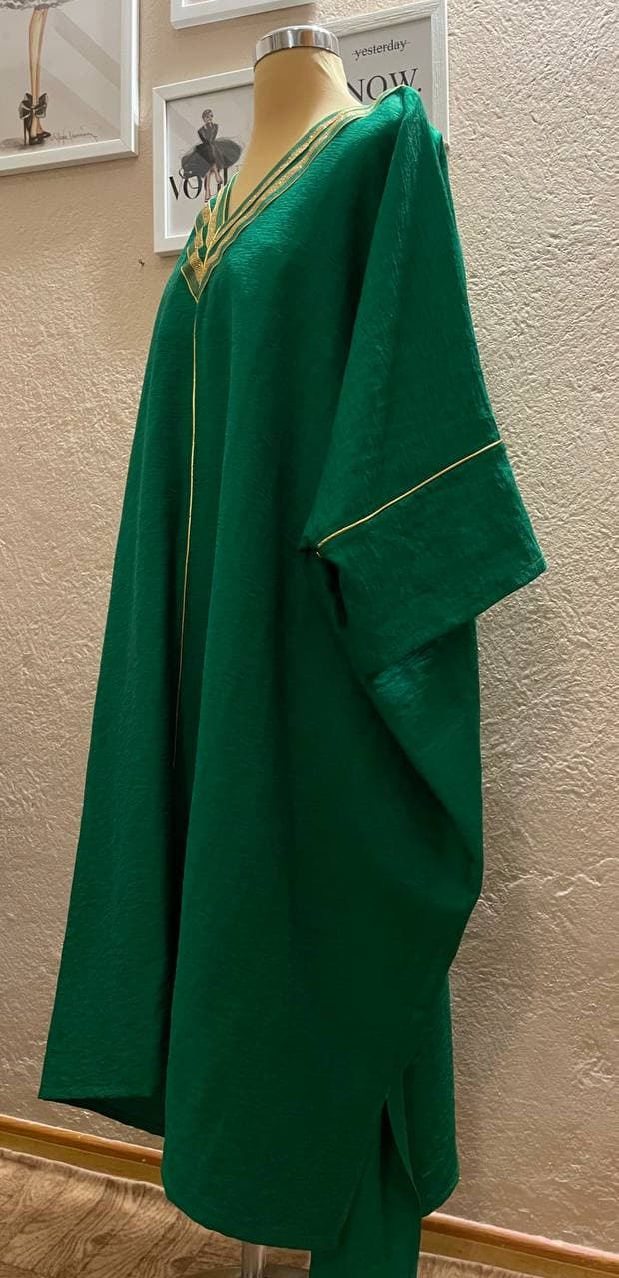
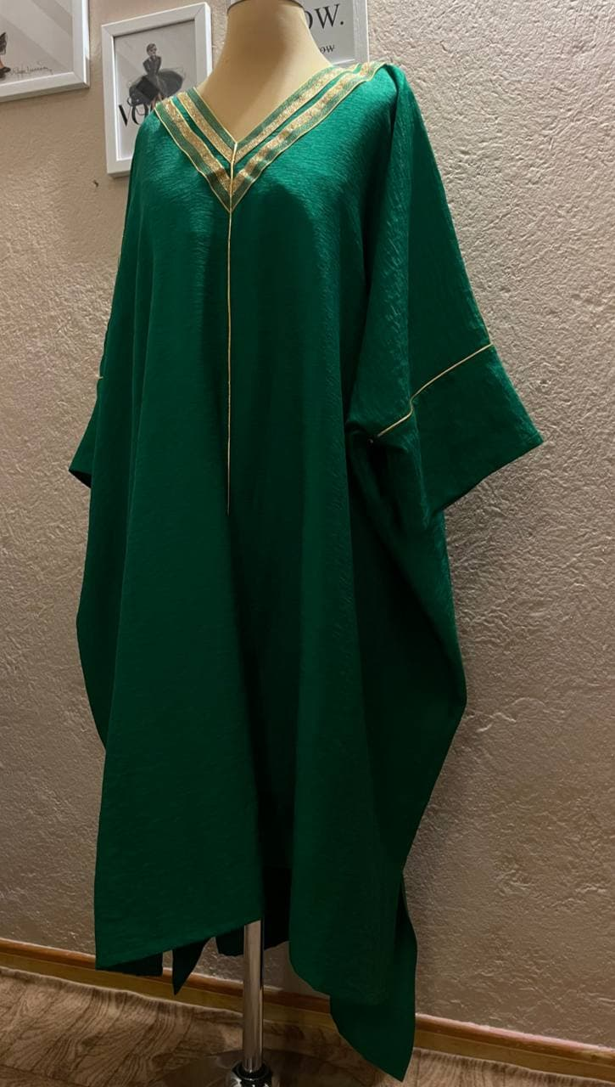
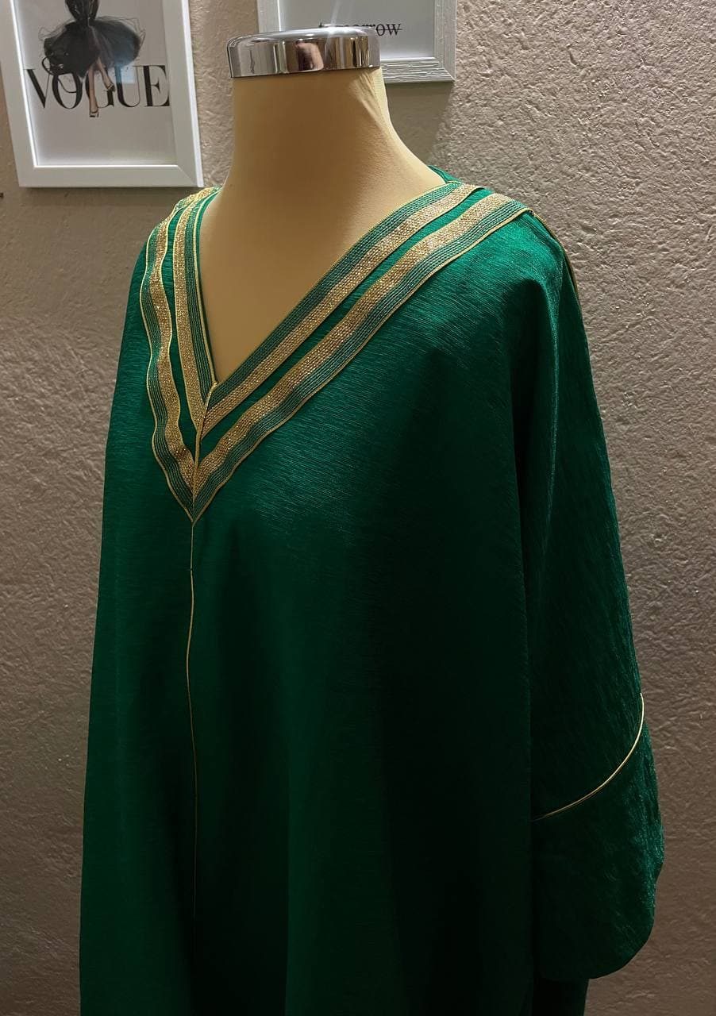
This dress is inspired by Arabic clothes, combining the green color of the fabric with traditional gold stripes is one of my favorites. The size of this dress is such that they can use it in several sizes.

Slide 12
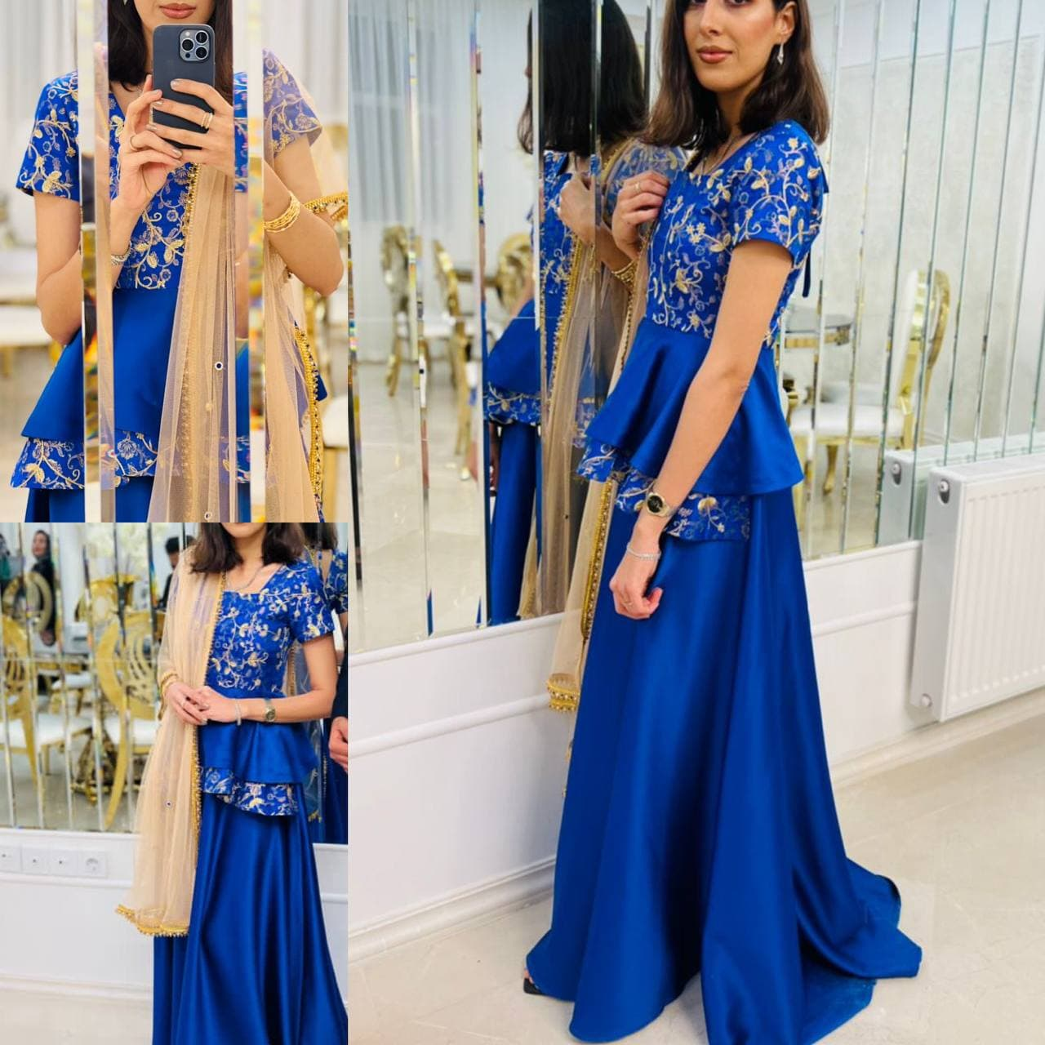
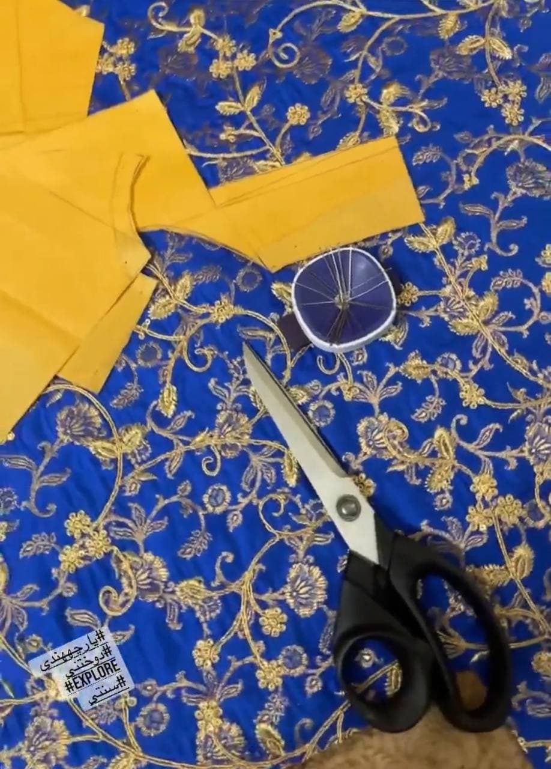
My favorite dress that I designed I got ideas from Indian clothes, cheerful and glamorous clothes with a scarf contrasting the main color of the clothes was the best combination that could be chosen.

Slide 13
Beautiful purple wedding dress for the engagement ceremony. Because our client was a Muslim, it was important for her to have a dress model that did not show off her body. She liked the height of the dress to be short, but since she was not tall either, I suggested putting a sleeve on the sleeve and back of the dress to put a longer silk to show her height taller.

Slide 14
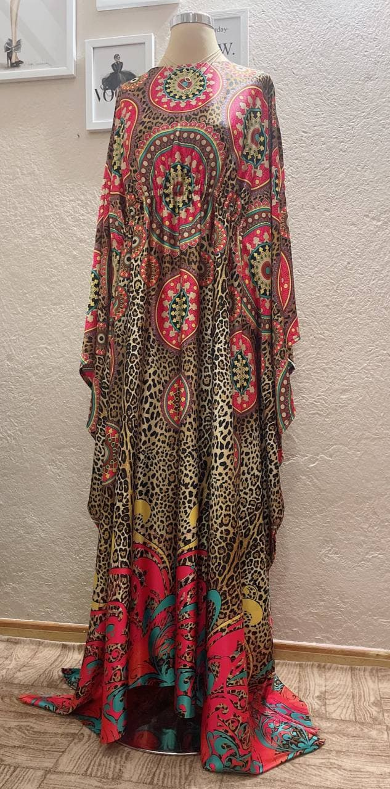
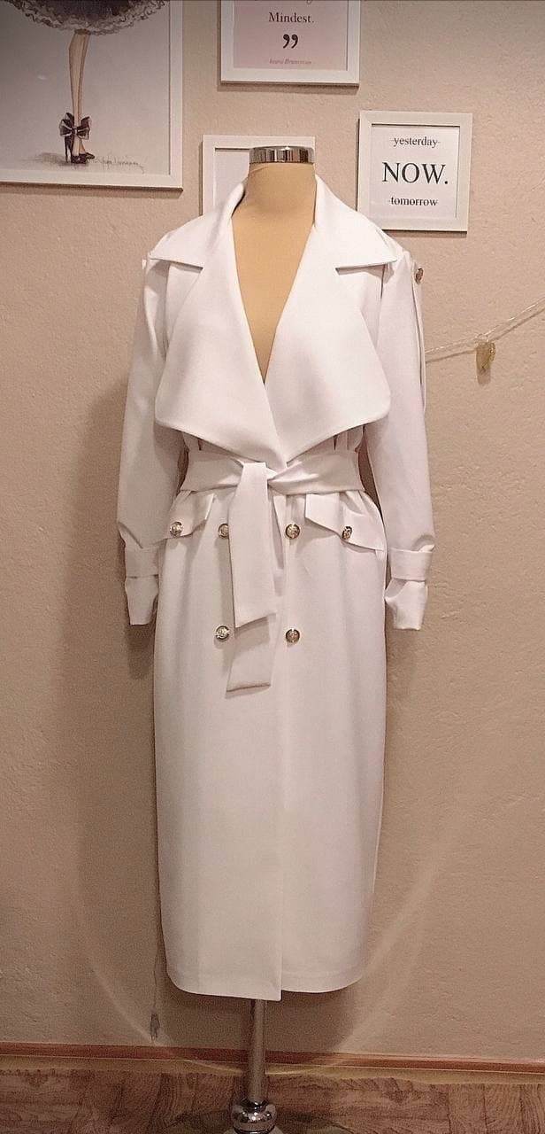
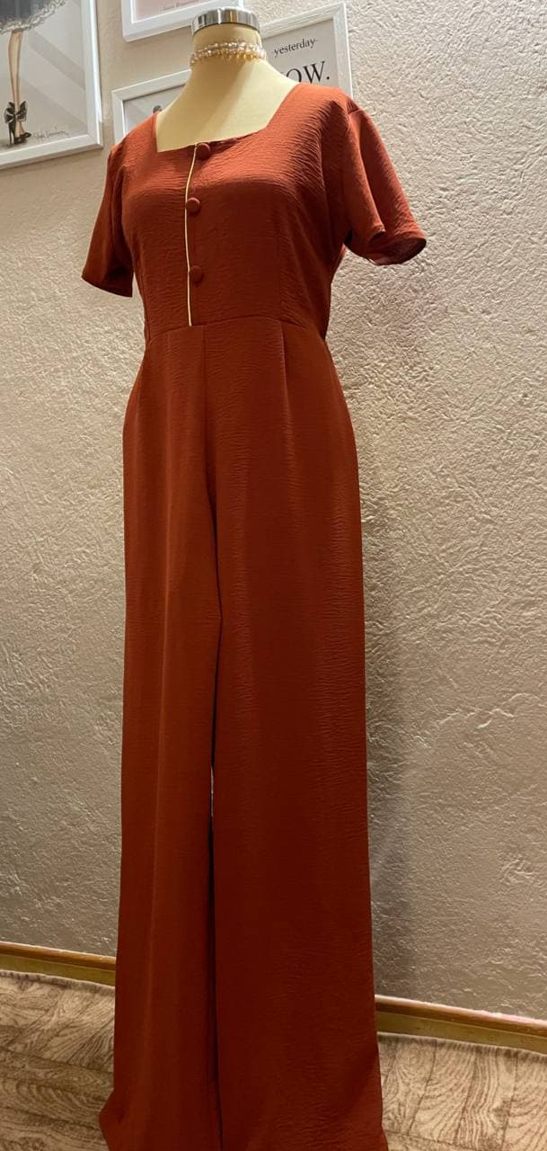
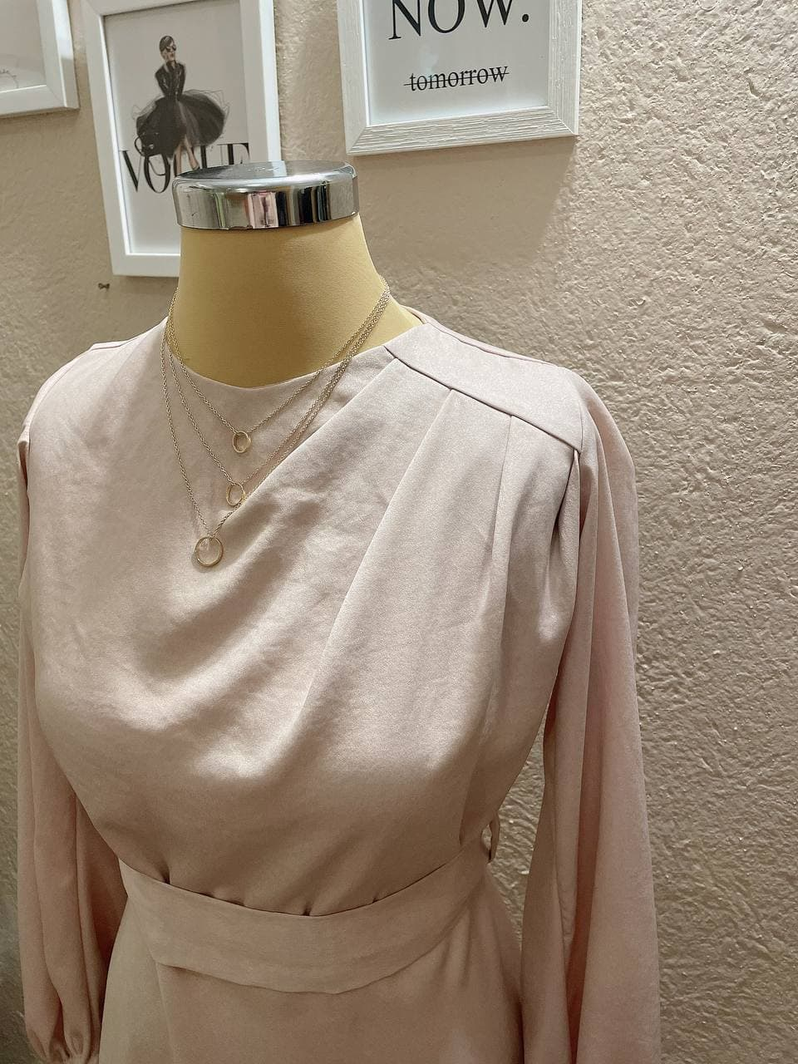
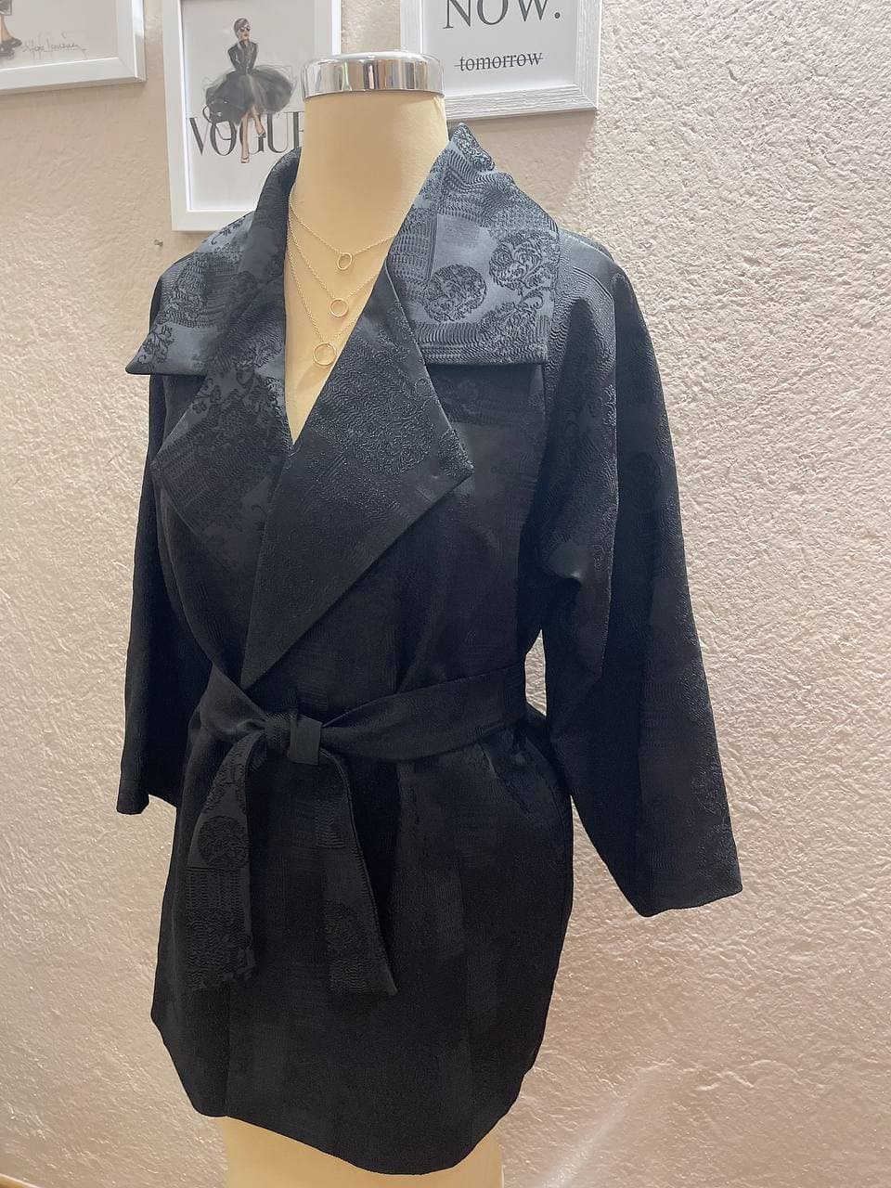
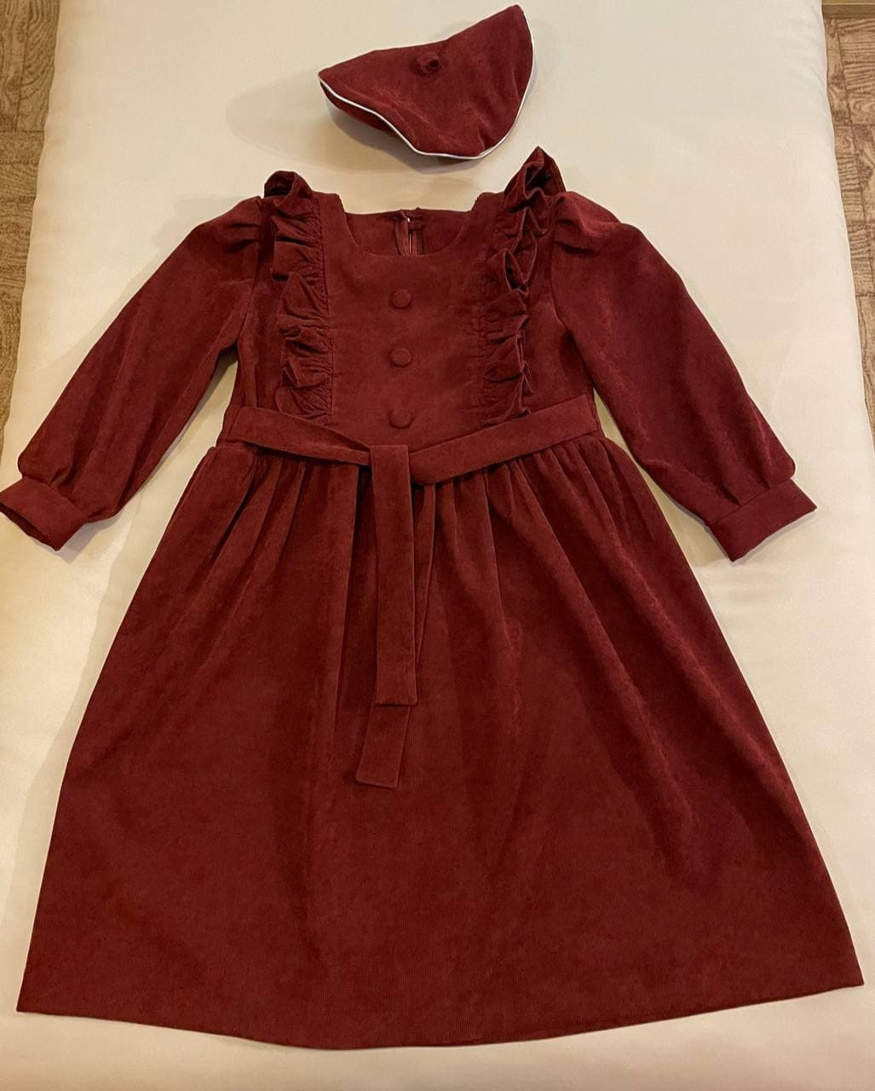

Slide 15
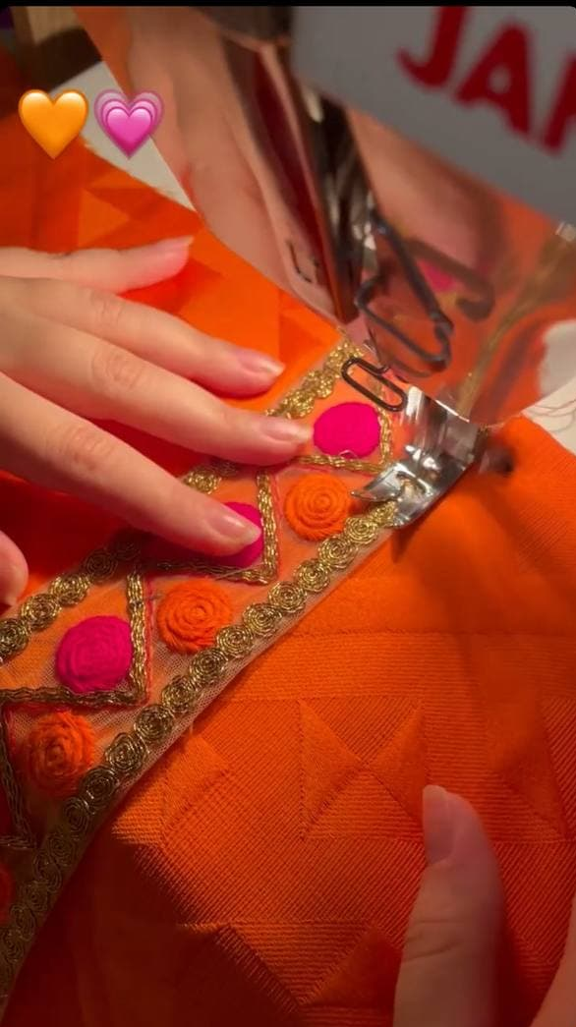
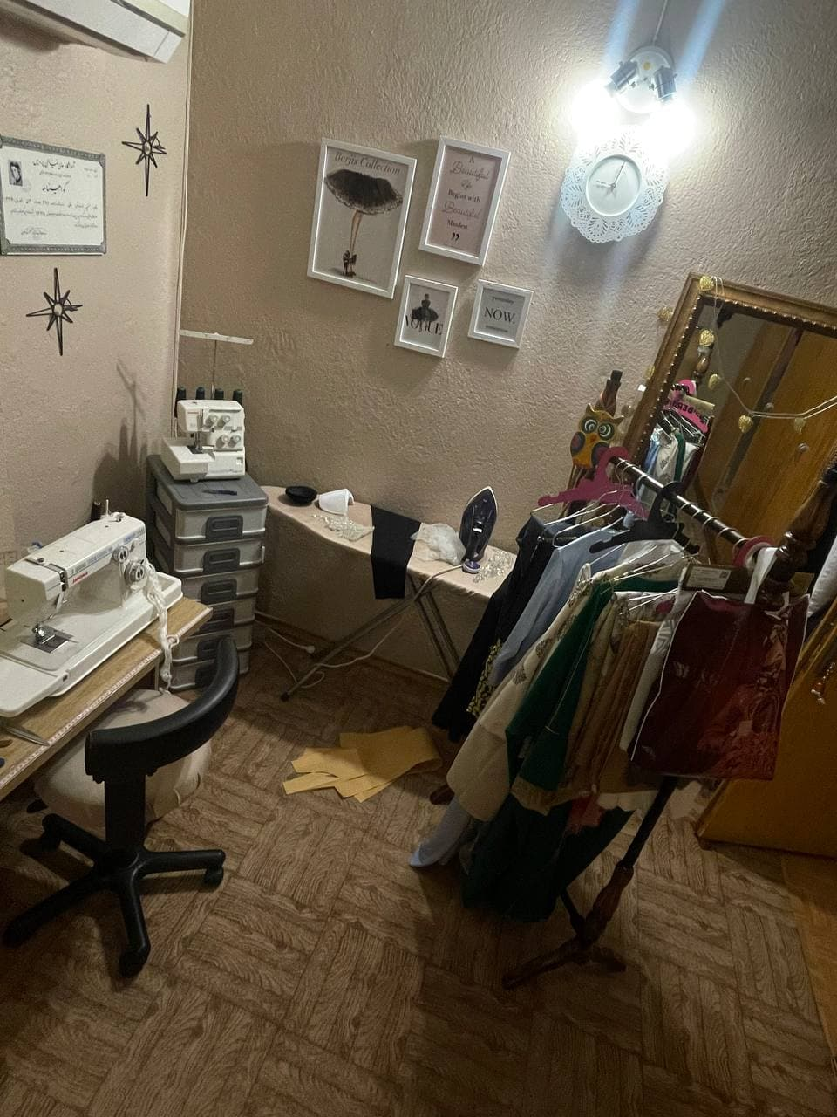
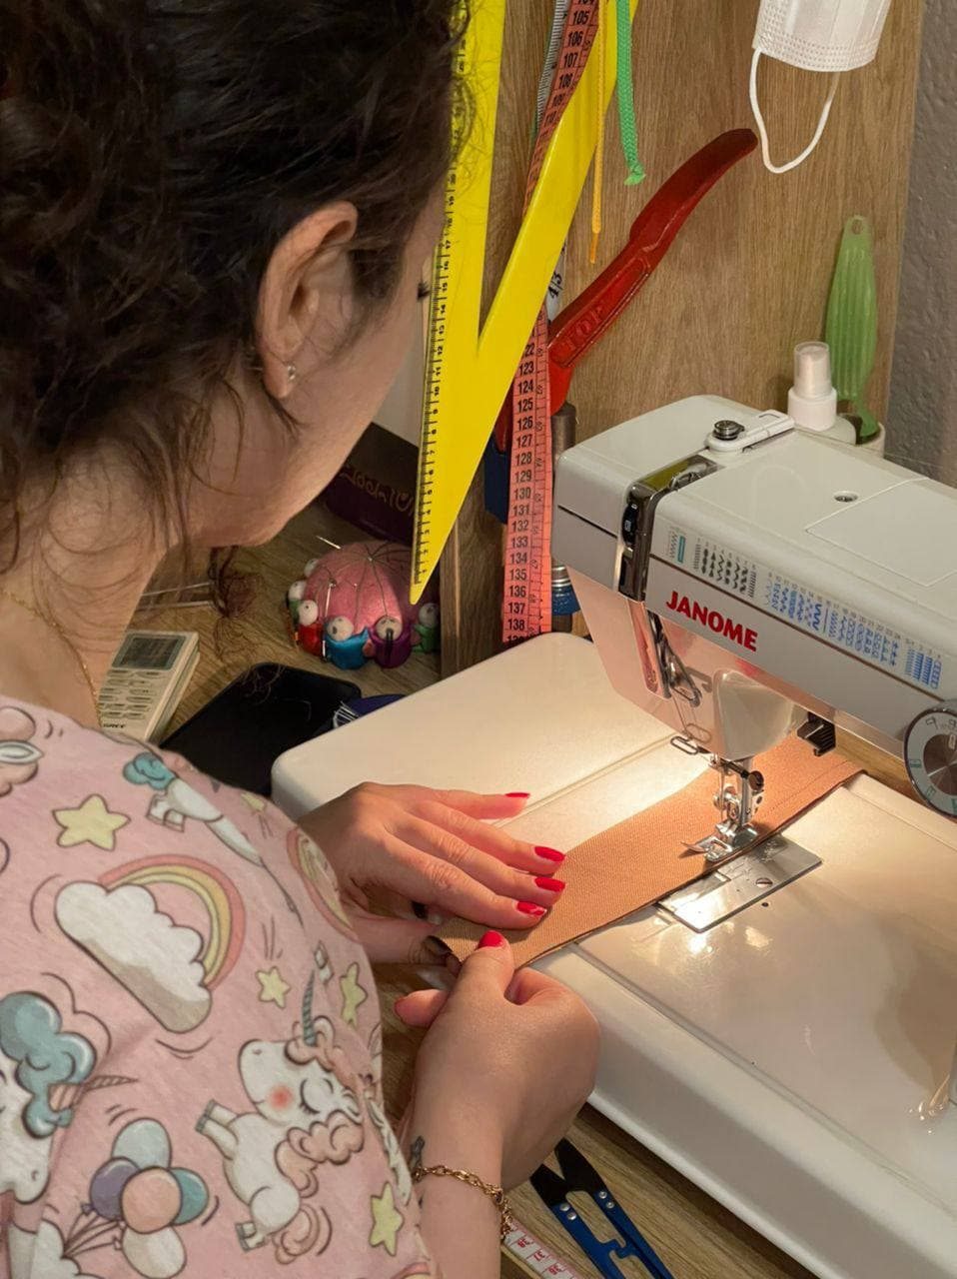
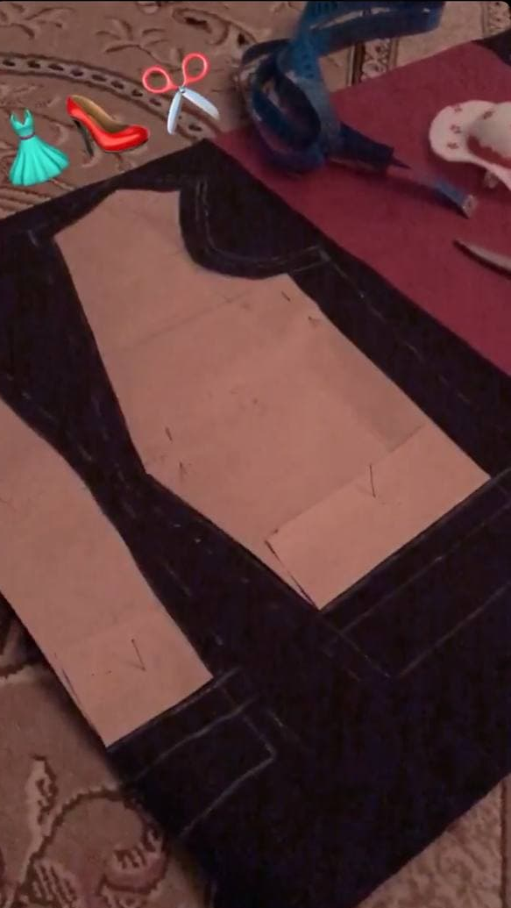
And its me.
it's hard to choose these photos from all the examples I had, but I tried to give an overview of all of them. I have been doing sewing for 5 years and it is interesting to know that both my mother and grandmother use this art. To increase my knowledge in this art, I do everything I can to always have something new to say for my costumers. Thank you for giving me the opportunity to show you my work, I am sure I will succeed in this way.

