Slide 1
Presentation:
-Vionnete
-Research
-My project proposal

Slide 2
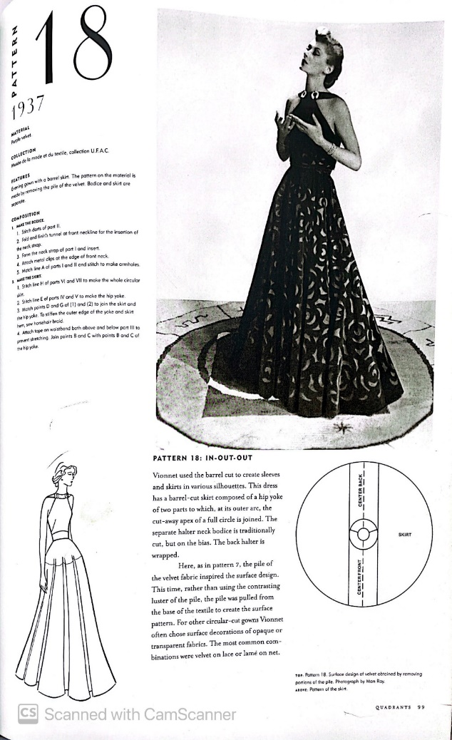
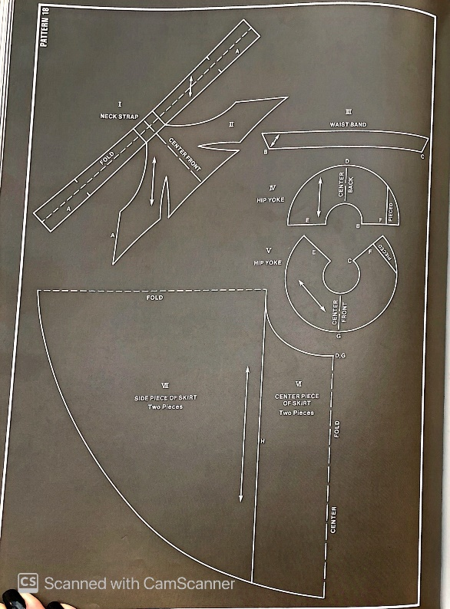
Vionnete Project

Slide 3
The reason why I choosed this model was that it was very modern and fits with today's fashion world. And I generally like to work with clothes that are oversize because these clothes cover body defects.
Blouse and skirt

Slide 4
I use a Japanese pattern to sew my dress.when I realized that this pattern should not be used,I had printed it in a large size.Because Maria said that some parts of that pattern has problems,I spent my time on the pattern and compared the sizes,the placement of the pattern with the original pattern to make sure it is correct.
And then cut the fabric.

Slide 5
Wherever it was said in the pattern, I put the fabric diagonally and folded
I used almost 6 meters of fabric. The reason for this was that there was a lot of waste of fabric in the upper part because I had to cut the fabric diagonally.

Slide 6
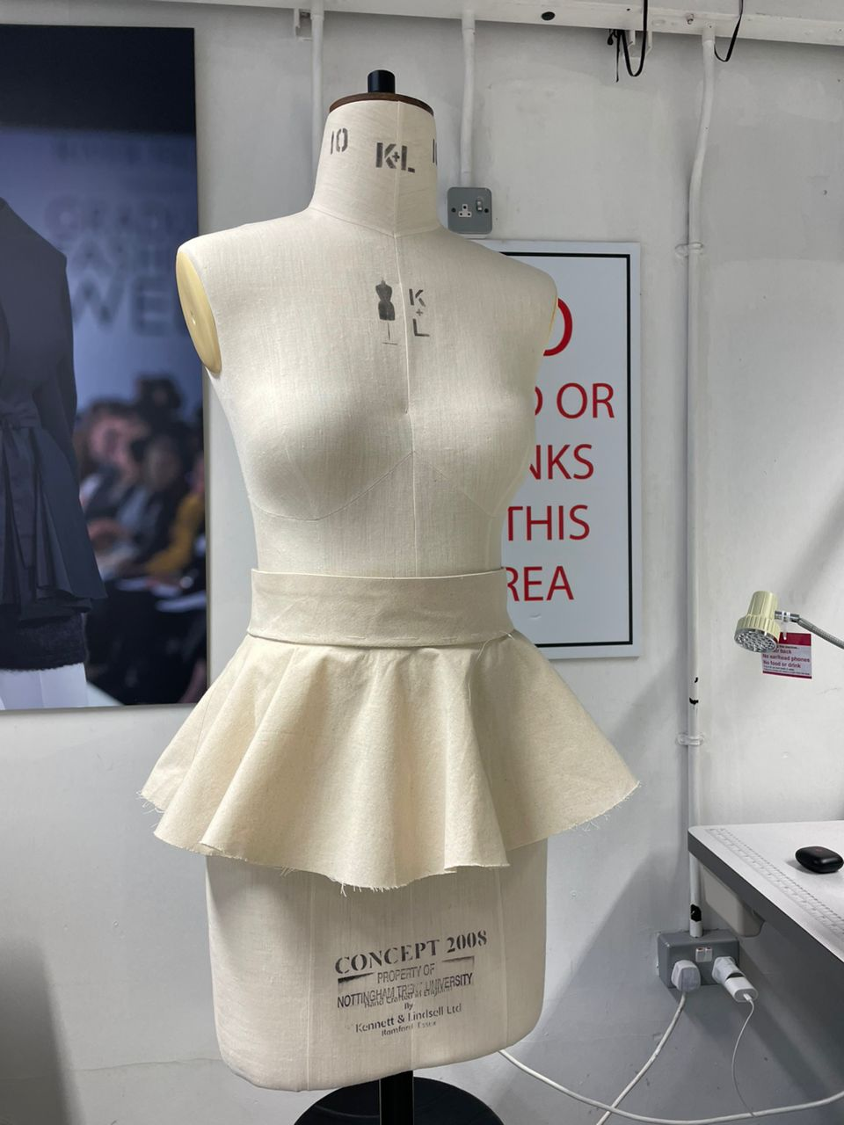
I attached the waist of the skirt to the first floor of the skirt

Slide 7
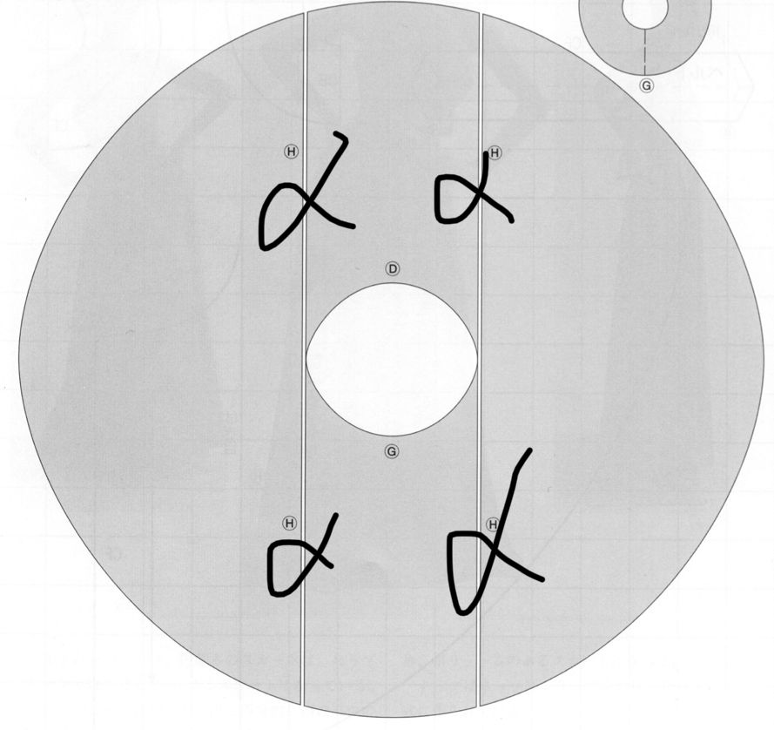
In order to make the lower part of the skirt to become more wider, she used a cut, and she put that part separately in the skirt cut.

Slide 8
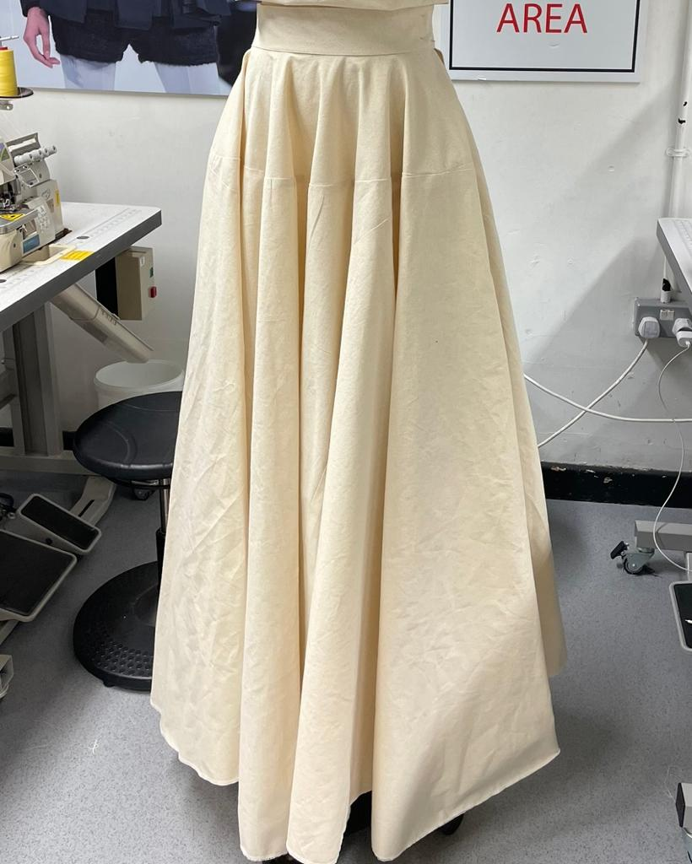
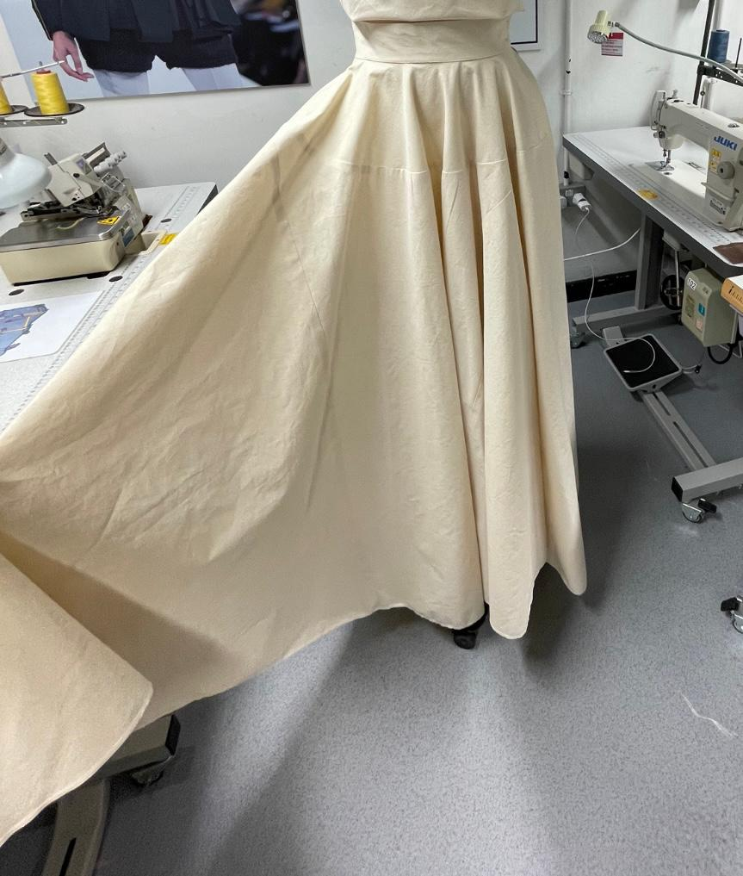
While when it is sewn, it is hidden in the skirt and you cannot easily see those cuts.

Slide 9
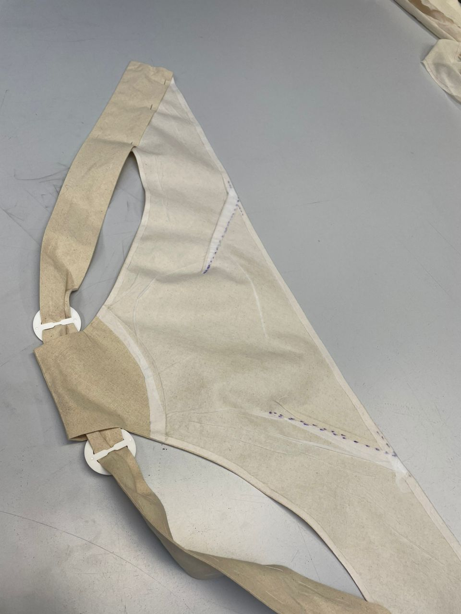
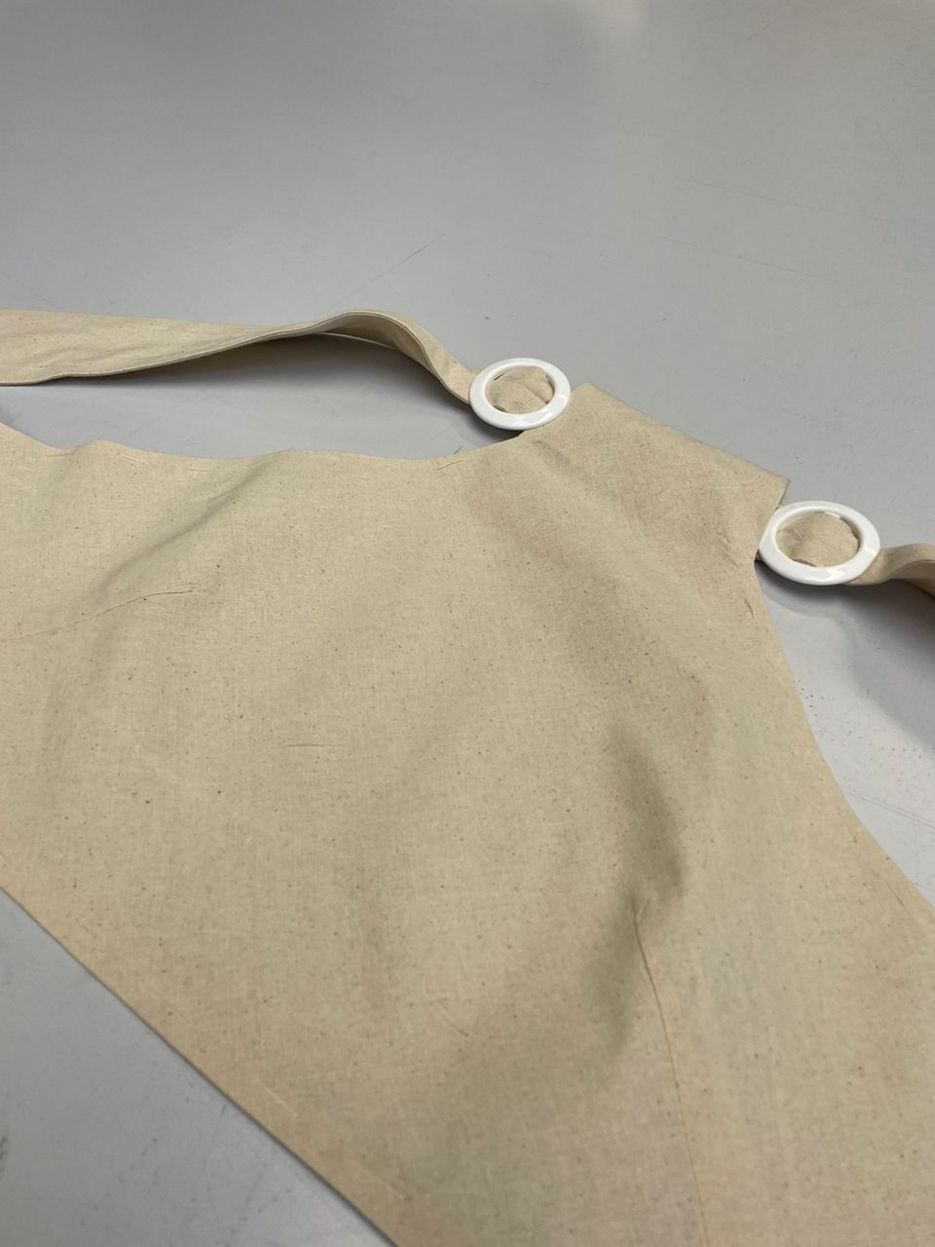
For the blouse part, I used calico fabric, and if I wanted to use another fabric to clean the inside, it would be too heavy to lining the dress, but since the inside of the dress was important to me, I used fusing. Exactly everything I had done on the main fabric, I also did on the fusing, such as stitching and darts

Slide 10
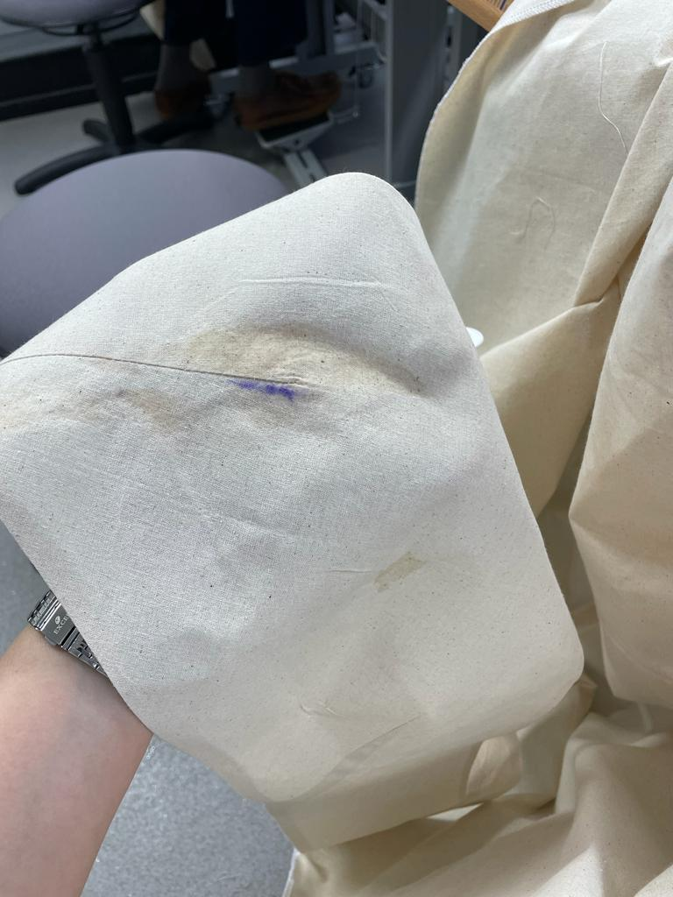
I can almost say that the work of the dress was finished when I was ironing the seams of the dress when the pen inside the dress returned the color to the dress.

Slide 11
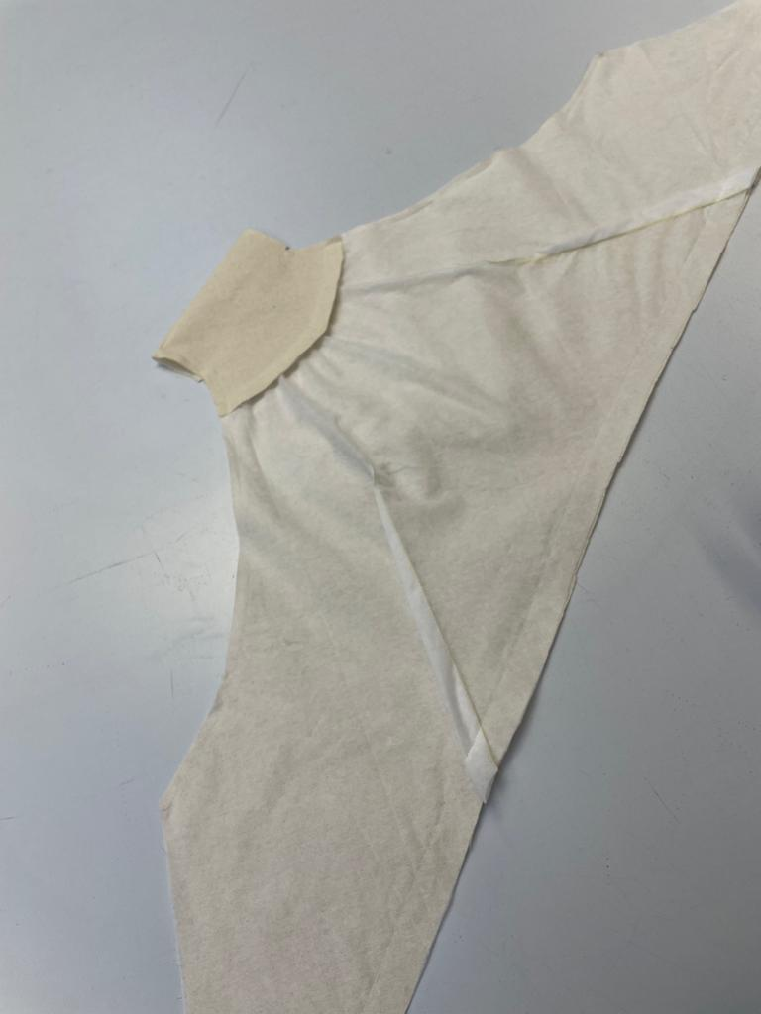
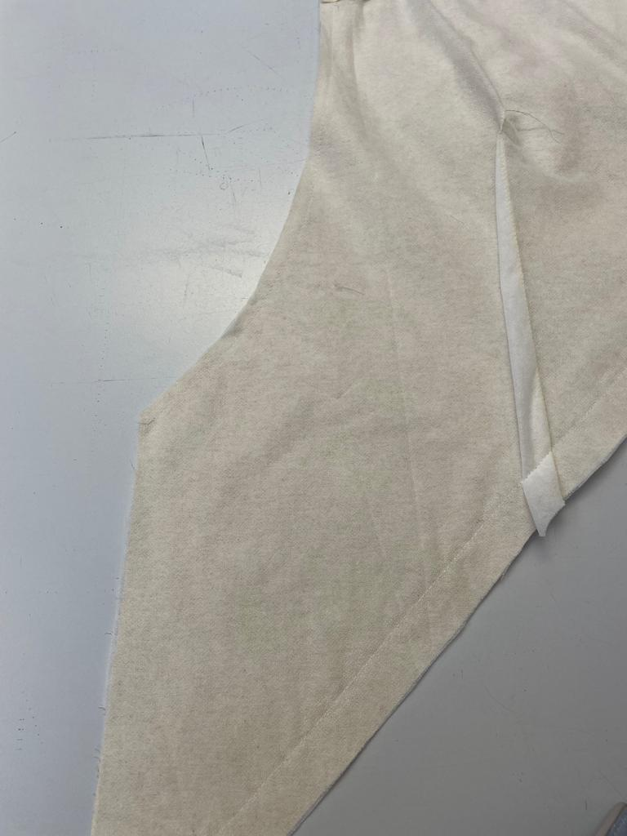
Unfortunately, since I could not remove it even with liquid, I preferred to cut and sew the top of the dress from the beginning. Although I had to spend another day on it, it made me try to sew clothes once again, which was not a bad thing in itself.

Slide 12
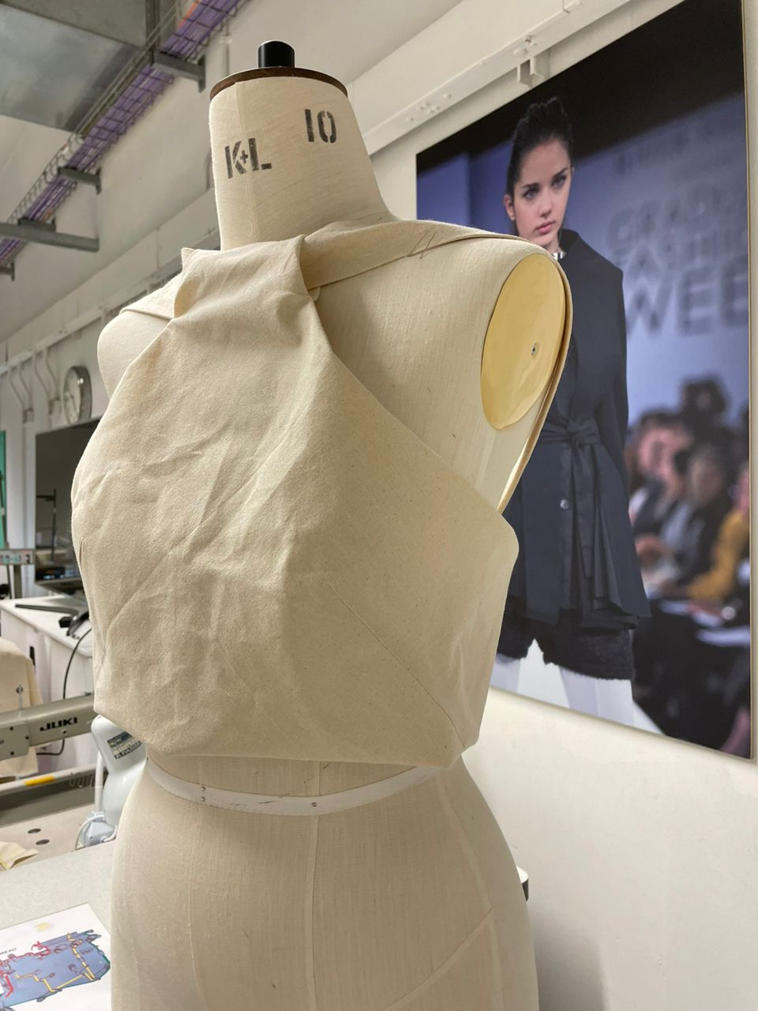
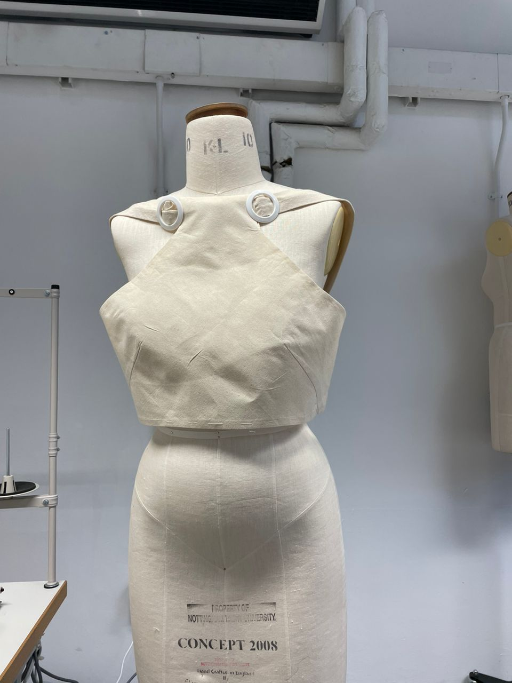
The presence of buckles gave the dress more beauty, which I chose not to skip. Passing the dress strap through the neck loop was another technique that was challenging, but I tried to cope with it.

Slide 13
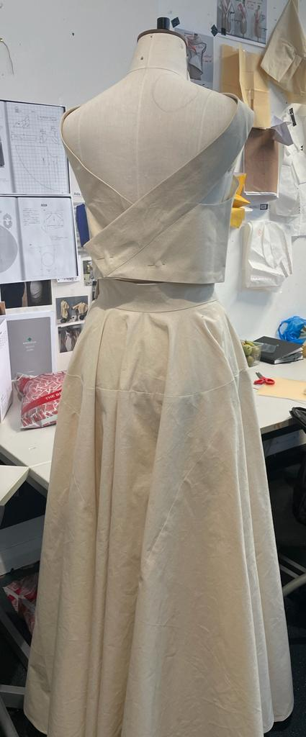
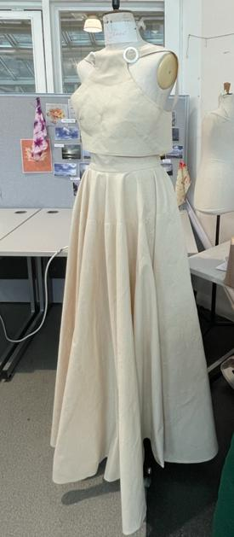
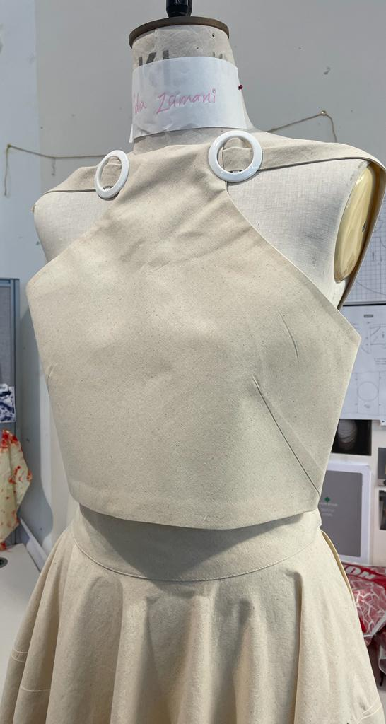
And the final one

Slide 14
Research&Final project
History of jackets

Slide 15
These days, I started to research about jackets to know when its history goes back and according to the research I did, it goes back to the 18th and 19th century when this style of work actually originated from riding jackets and first It was for men. but little by little, women also started using these jackets, for women, the same method was used at first, but over time, they designed specific patterns for women.

Slide 16
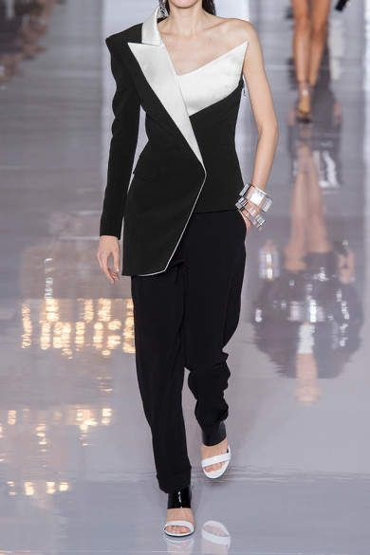
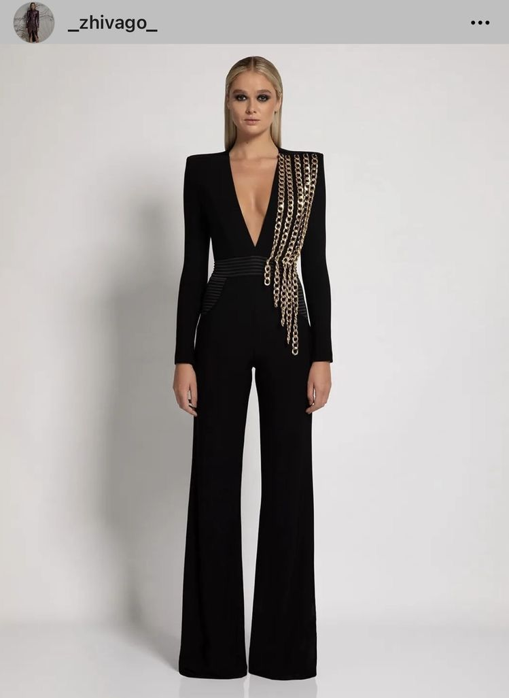
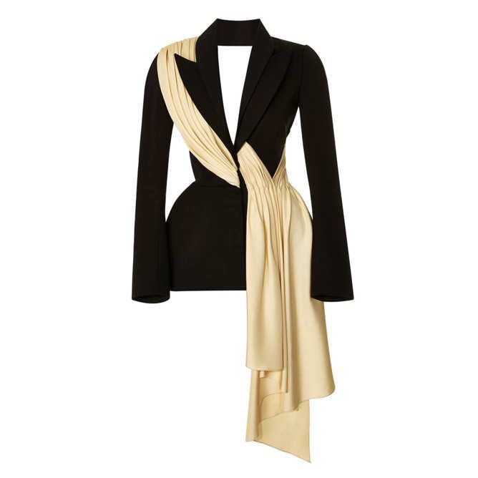
The main reason that made me want to be more active in this field is that this work style of this dress can be used in different times, such as a friendly party, a formal environment such as employment, and there is a special style that you can wear in any Use it at any time and in any season of the year, for example, in cold weather you use a coat that has a thicker fabric or lining inside, or in warmer seasons you use a coat that has a lighter and softer fabric. , or the amount of thread in the fabric is more, the coat is something you wear over the clothes and this makes your style more special because it can be seen on your clothes at first glance.

Slide 17
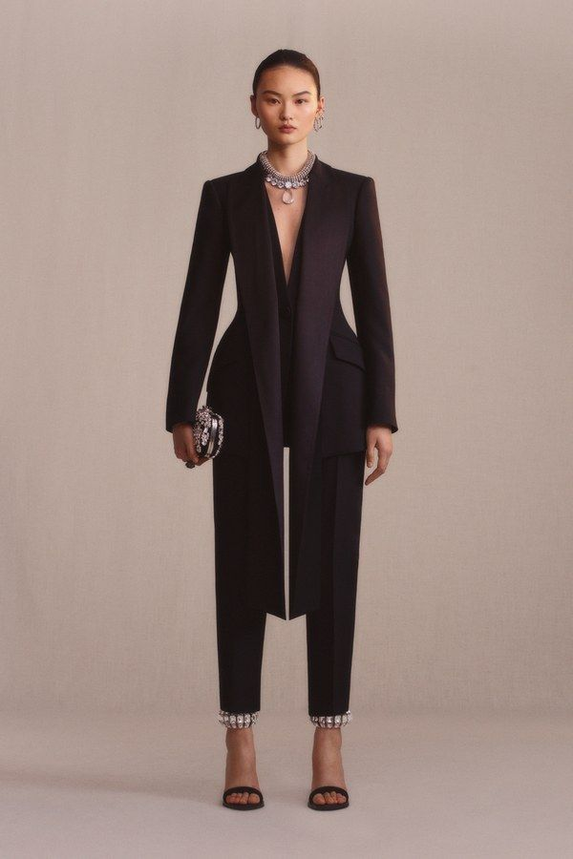
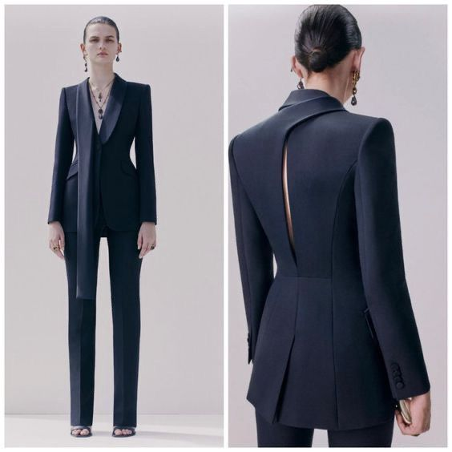
One of the other researches I did is related to the fashion designer Alexander McQueen, and I liked the combination of his works.

Slide 18
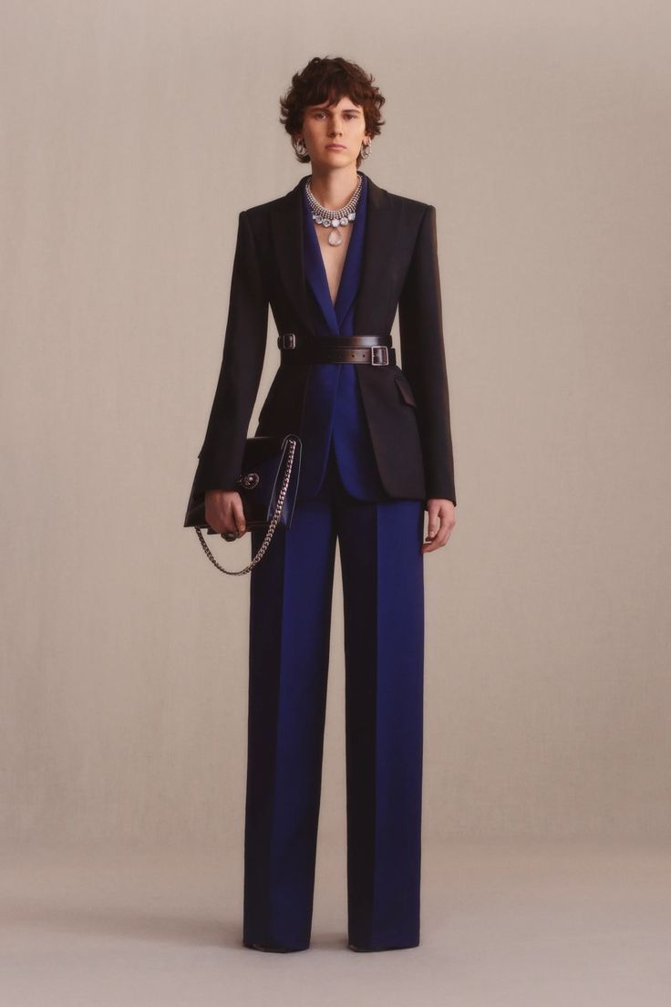
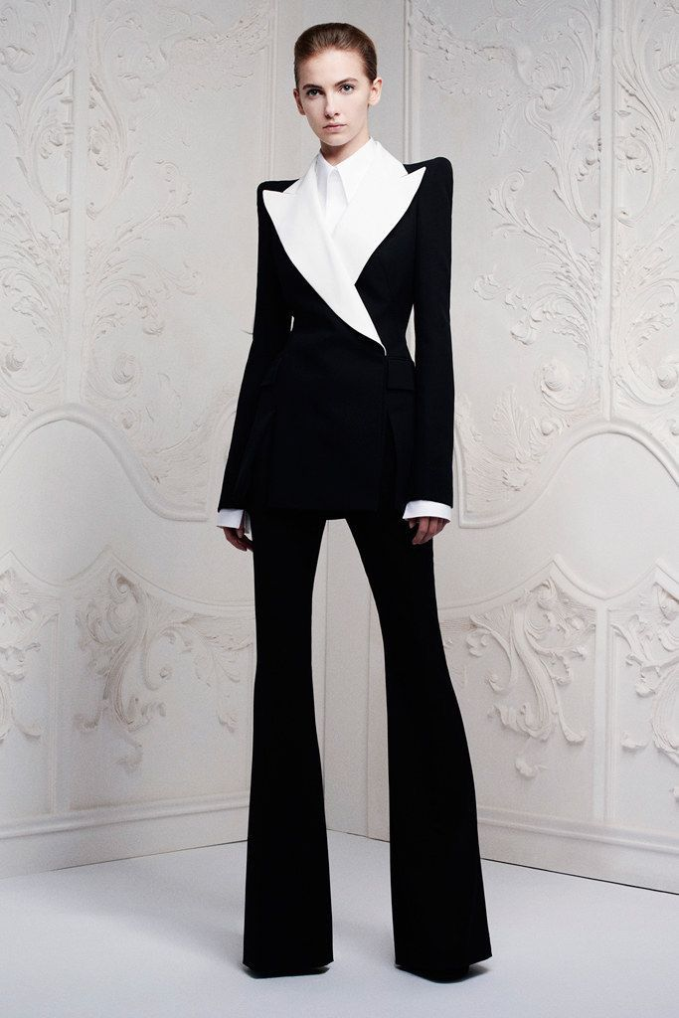
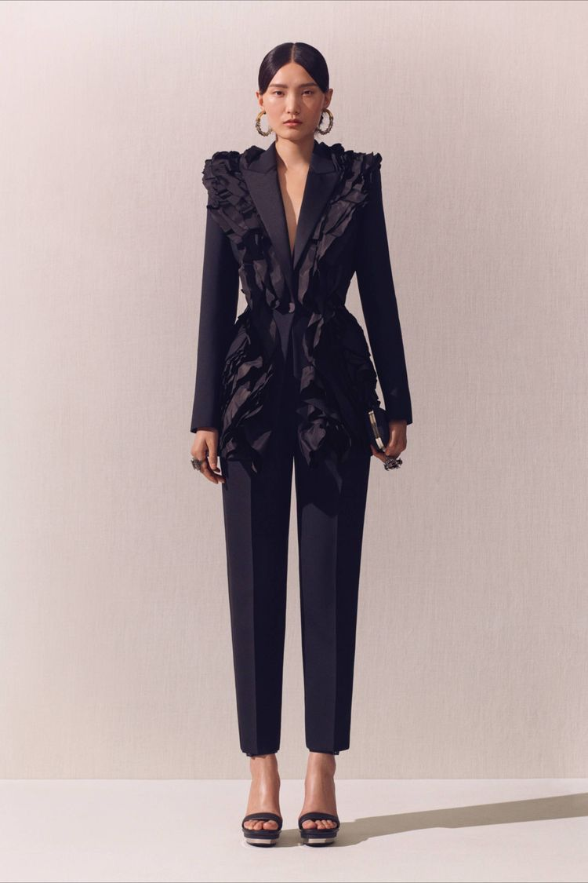

Slide 19
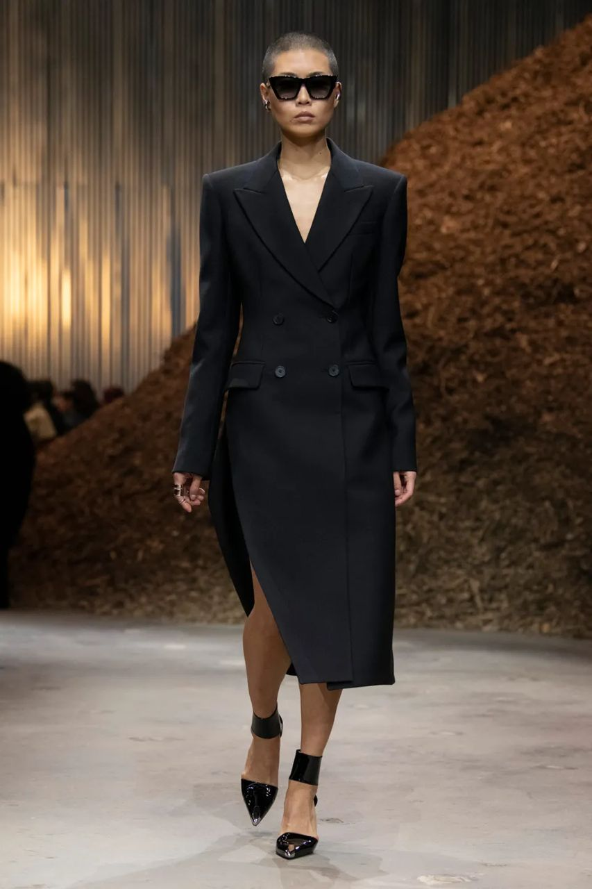
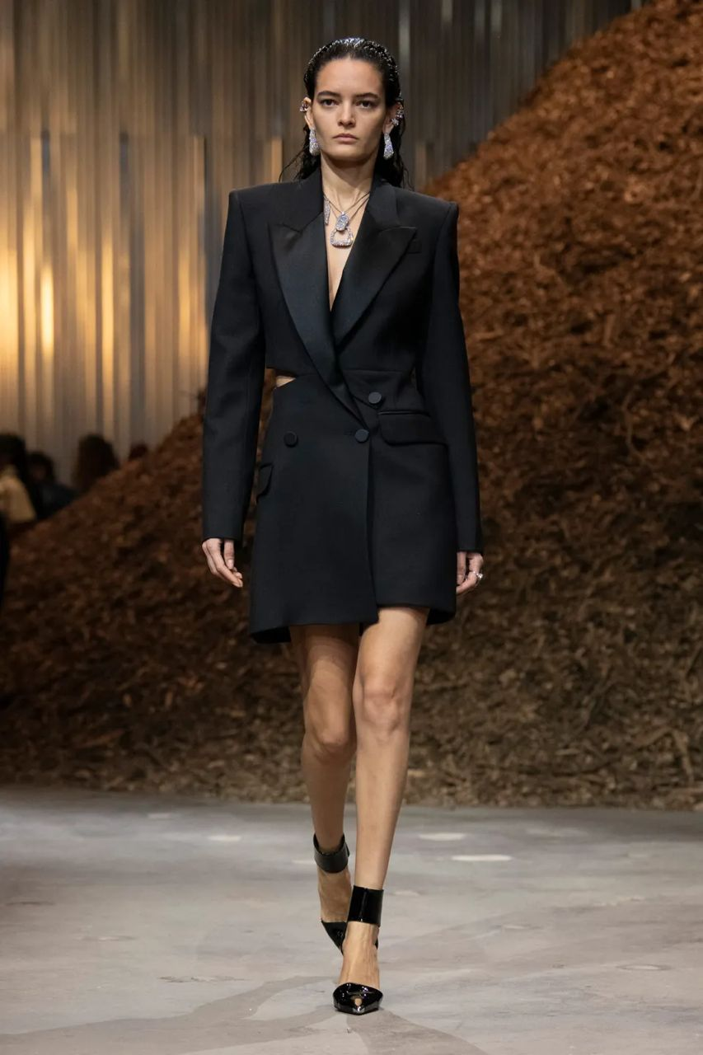
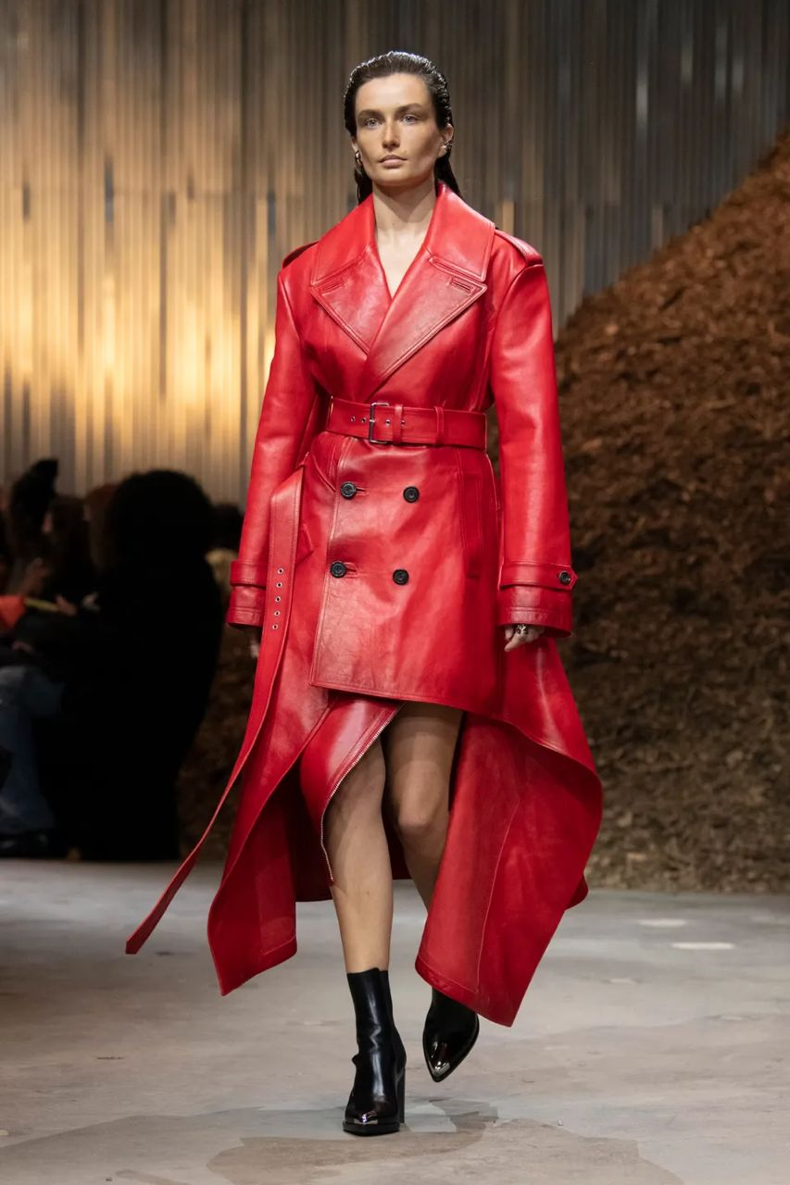
Fall and Winter 2022 McQueen catwalk The coats are designed with special cuts and are out of the weird state, most of the works are oversized and asymmetrical, which makes them more effective, the combination of matte and shiny fabric for the lapel,or use From lace and crepe fabric.

Slide 20
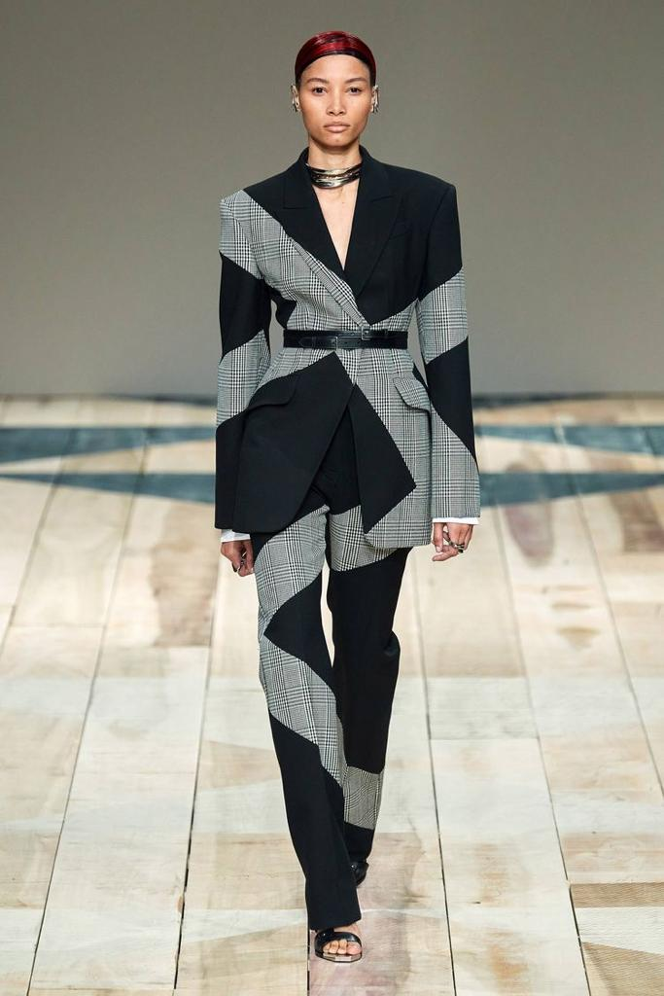
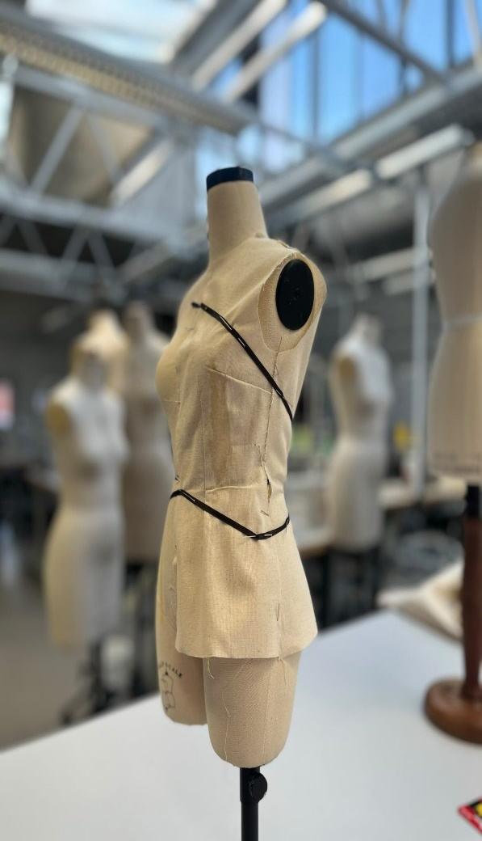
What I did was to come up with a combination of what I want to do in my final project, that is, combine the jacket with one of the designs of this brand and Maria's method as I told before to use this more in future I made a sample. I used to do most of my work on a paper pattern, but now I learned from the workshops that with a simple pattern, you can have a great idea for clothes, just play with the fabric on the mannequin.

Slide 21
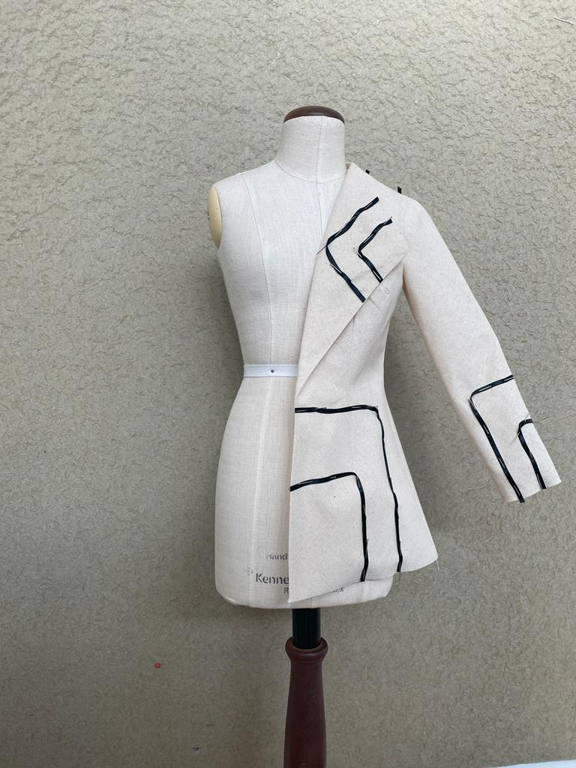
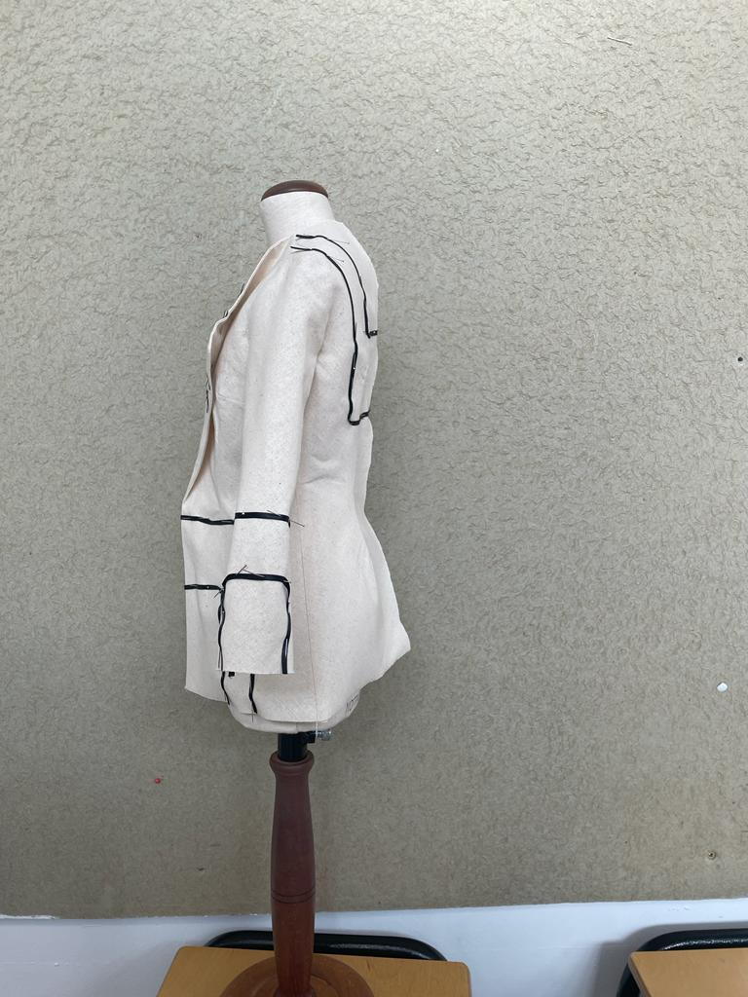
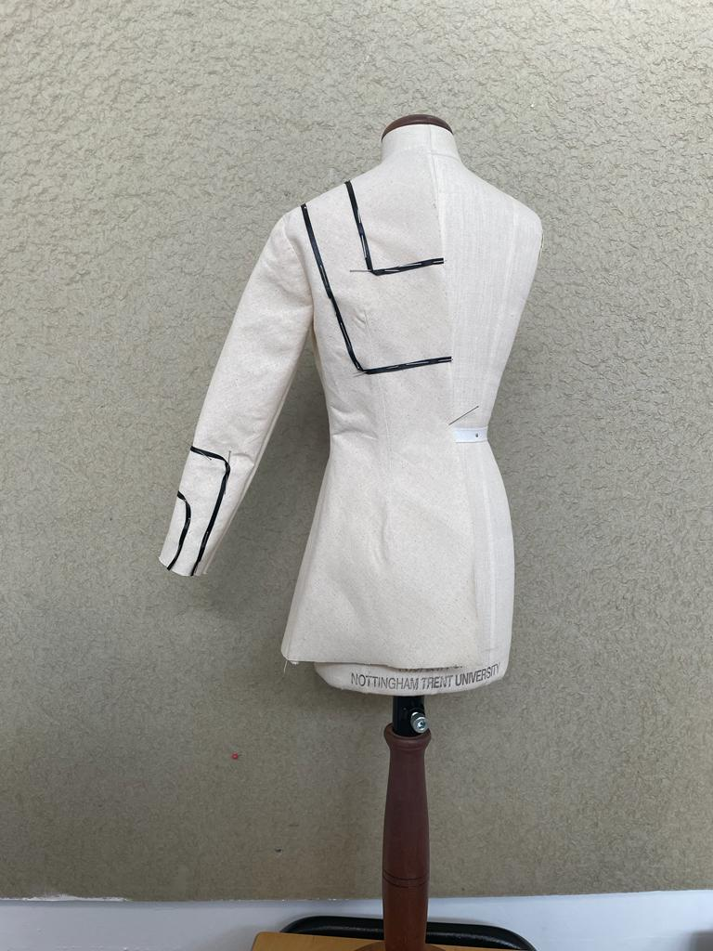
First, I combined the work in shape and did not destroy the darts in this part.

Slide 22
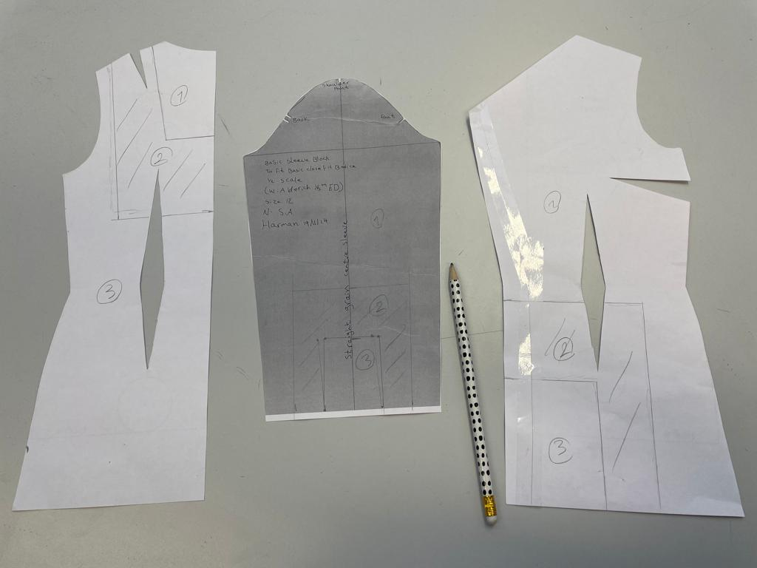
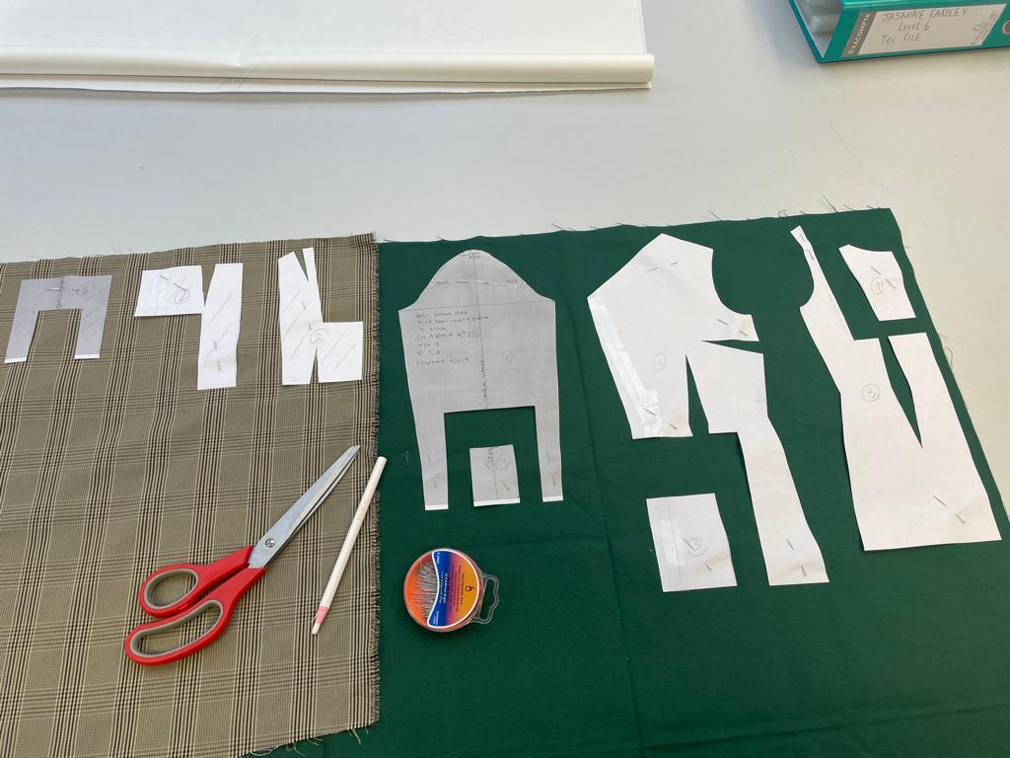
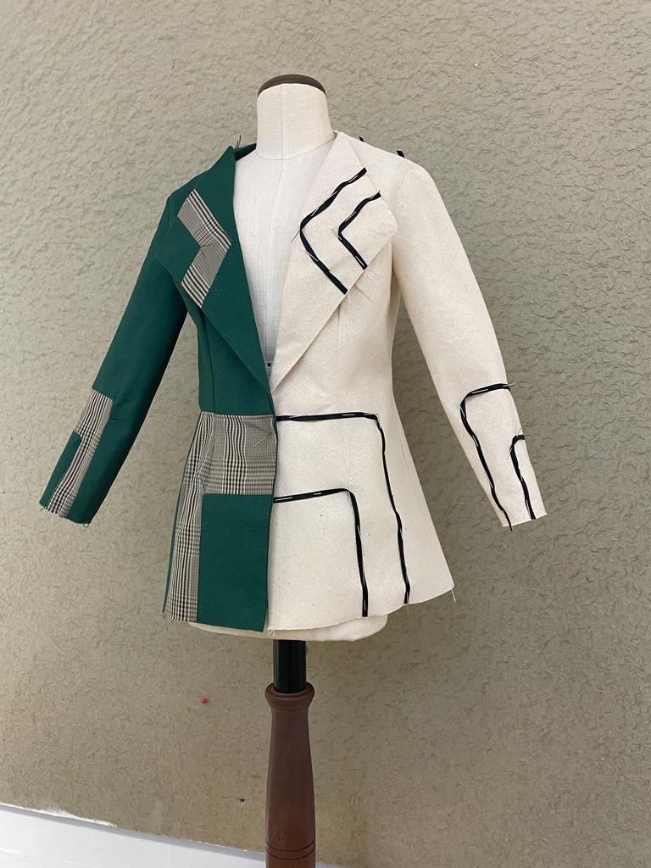
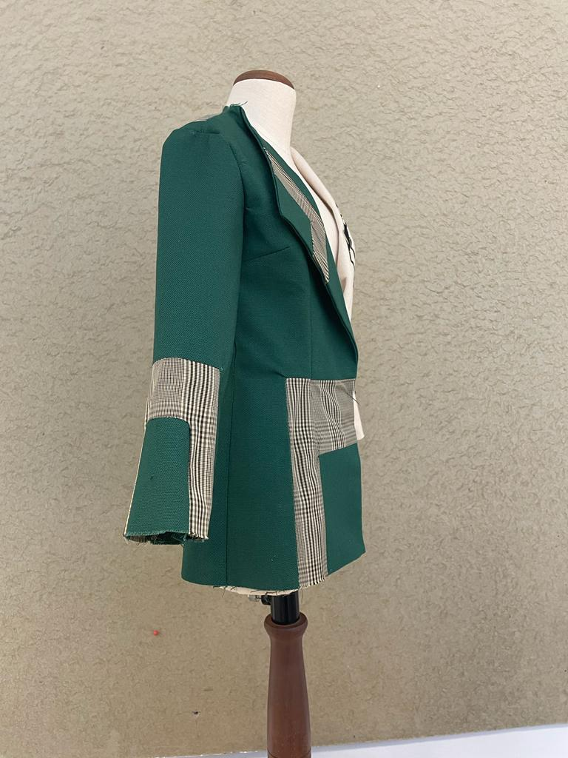
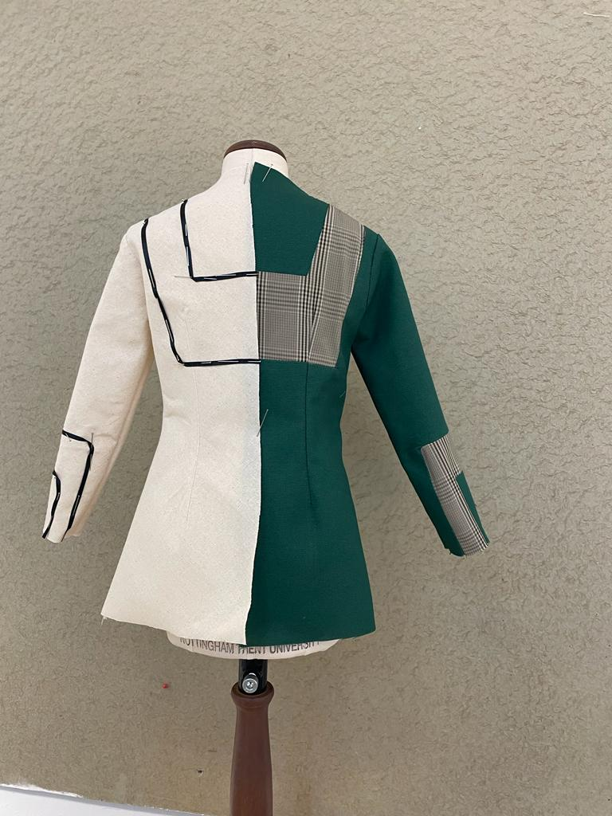

Slide 23
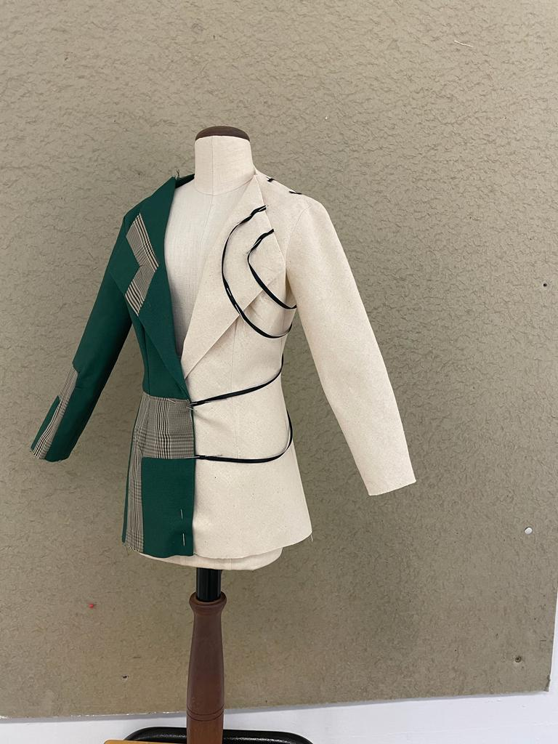
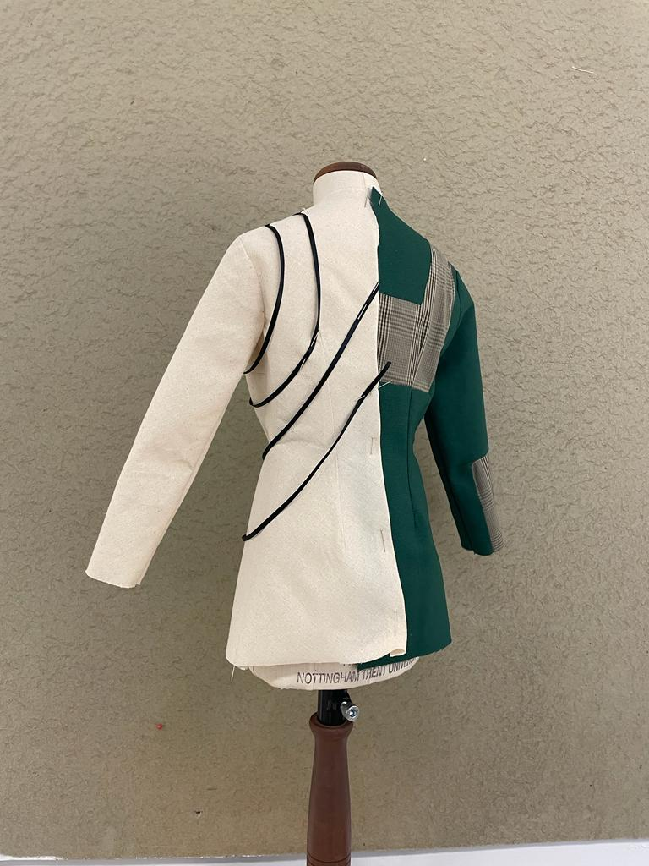
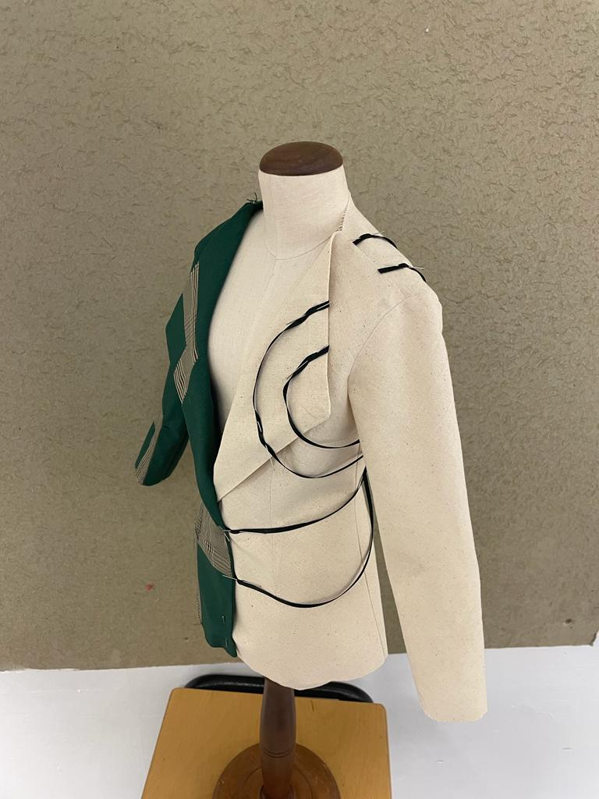
And after that, I tried to style the pieces to have a different style, and for this one I also removed the darts.

Slide 24
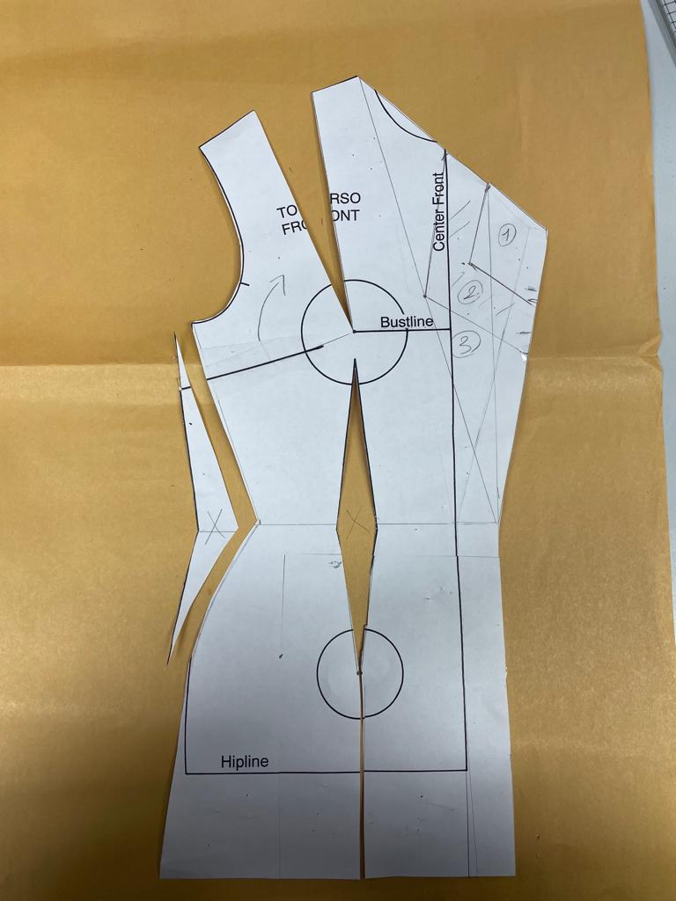
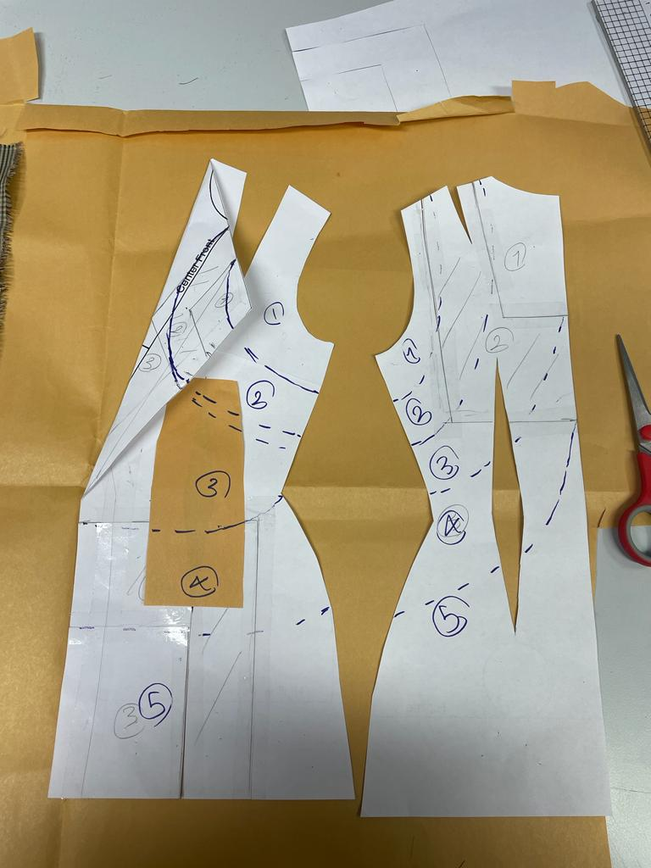
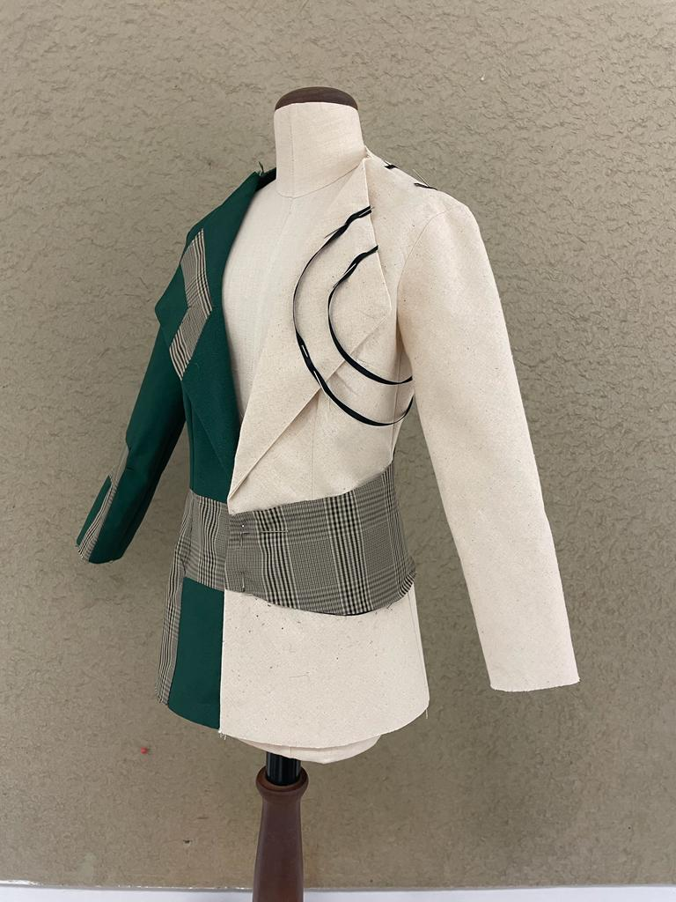
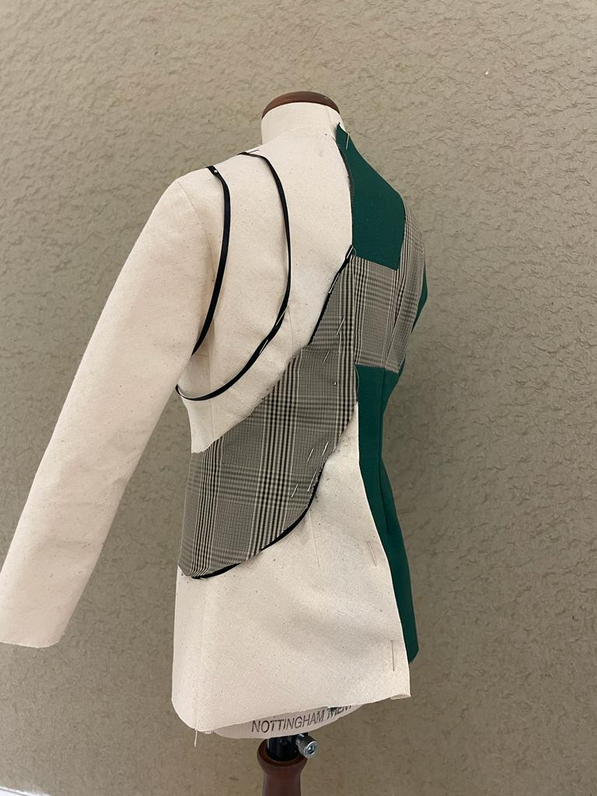

Slide 25
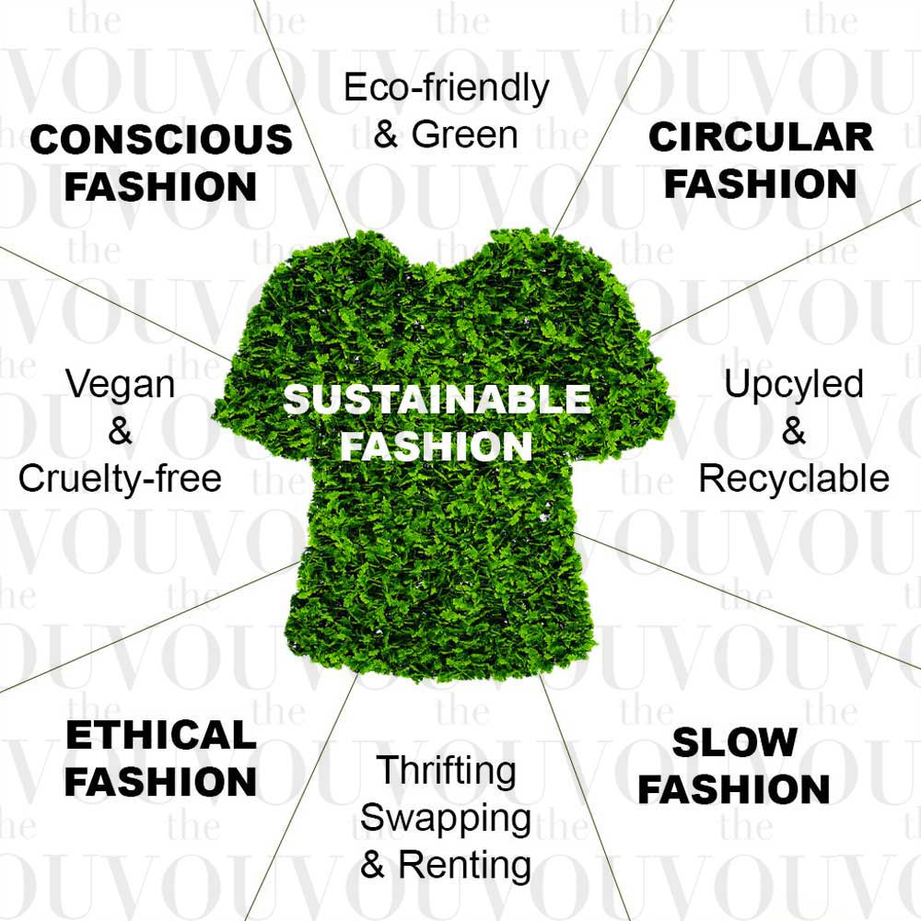
Sustainability:

Slide 26
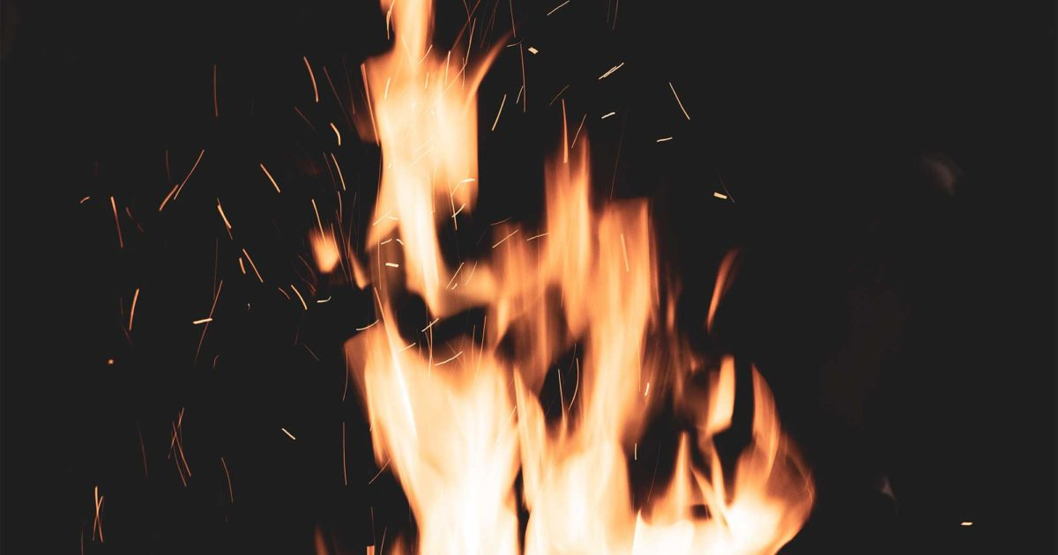
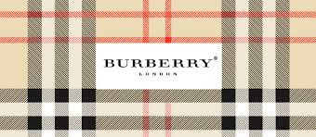
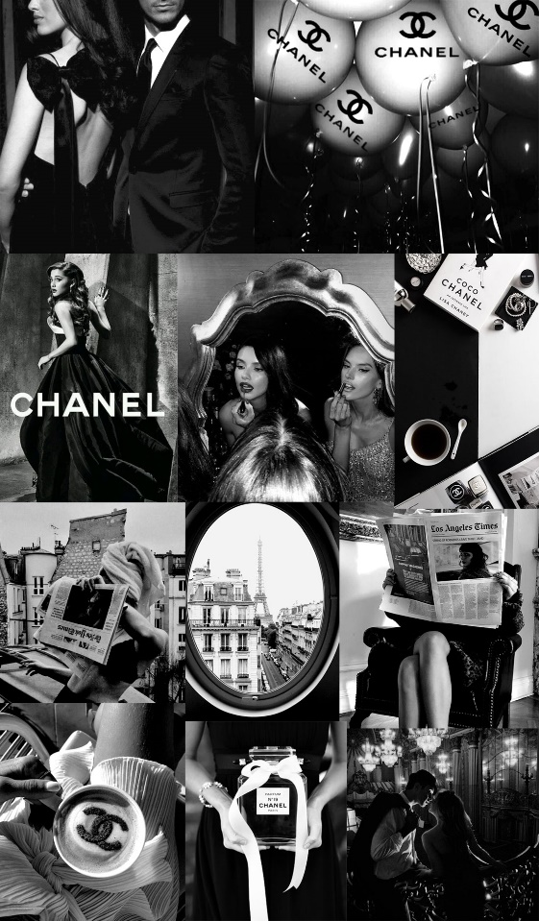
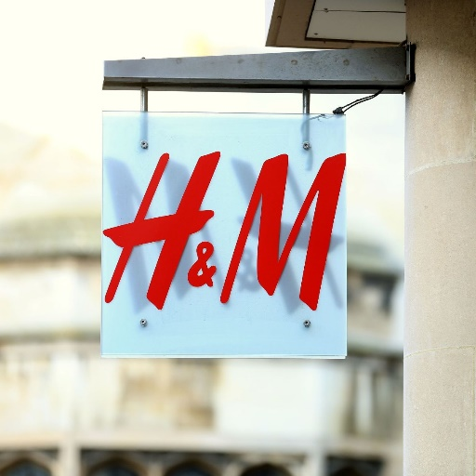
Bad news :Burning clothes. The story is that the "exclusivity" of the products is very important for this producer of luxury and expensive goods, so that he is ready to burn all his stocked products, but not discount them and the low-income strata of the world cannot afford to buy these goods. This famous English company, which was founded in 1856 by Thomas Burberry in the city of Basingstoke, used the term "wrong people" for the class whose income is not enough to buy from this brand. This routine is common among the world's luxury brands, and these brands prefer to completely destroy their warehouse products instead of offering them to the market at a lower price. Among them, we can mention luxury brands such as H&M, Louis Vuitton and Chanel.

Slide 27
For sure, this is one of the worst things that can be done because we know how much energy is used to produce these clothes, if they can be offered at a lower price so that they have more customers.

Slide 28
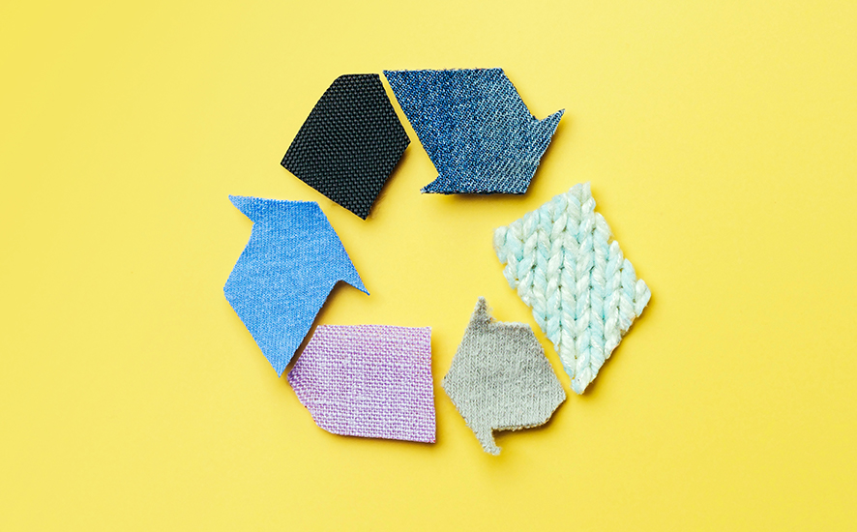
Another way that I choose to have this sustainability is to use as much as possible fabrics that are either recycled or recyclable so that less harm is done to the earth.

Slide 29
According to my research, fabrics like: Hemp,Organic cotton,Organic linen,Organic Bamboo,Corc are some of them. It is interesting to know that these fabrics do not even harm animals, and if you are a supporter of animals or want to have vegan customers, these fabrics are one of the best choices.

